Slide 1
Master’s Thesis
Final Presentation
08.08.2024
Notes:
Hello I‘m … and welcome you to this thesis about ….
In cooperation with Bosch Smart Home company

Slide 2
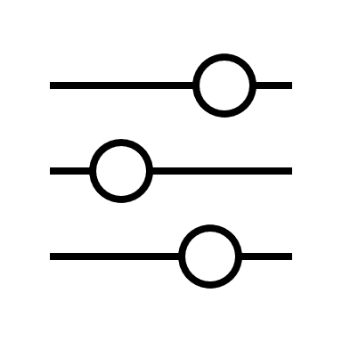


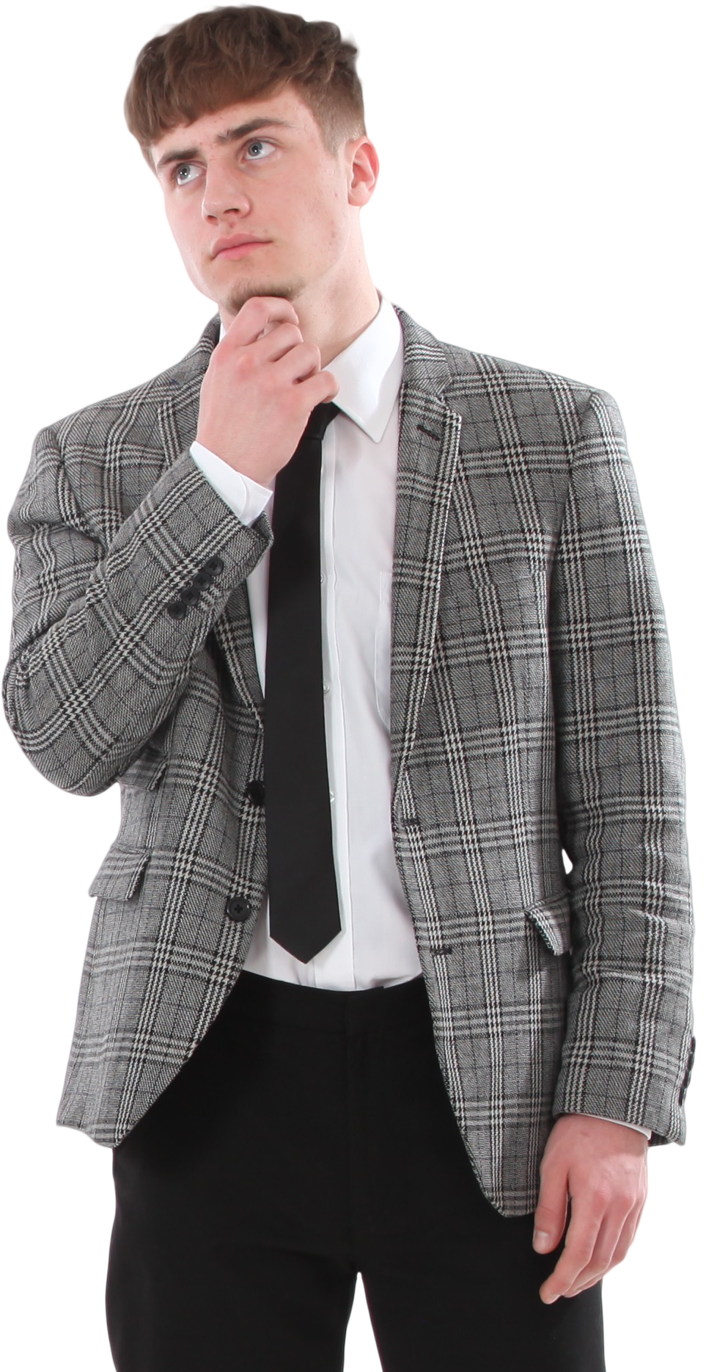
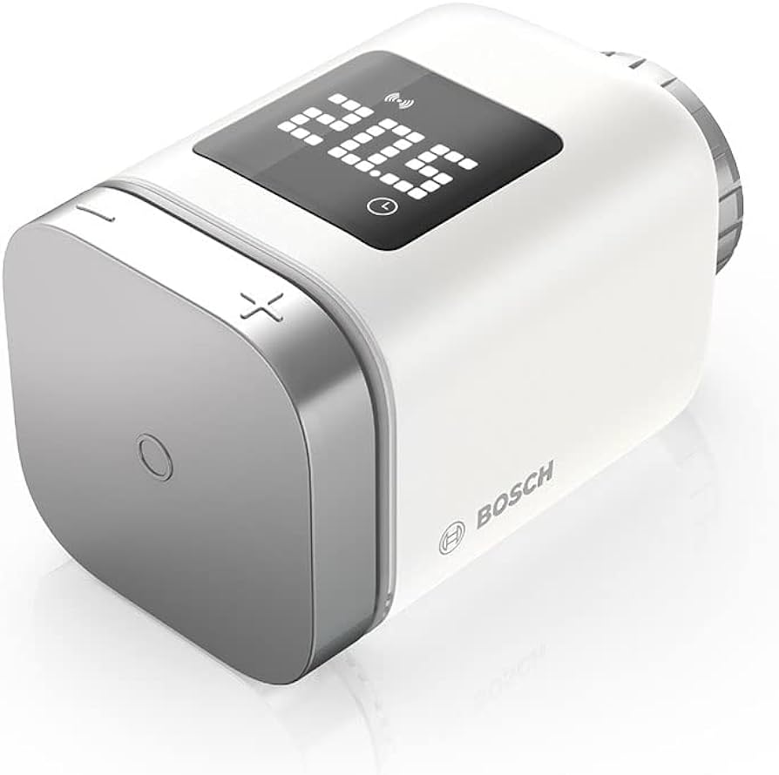

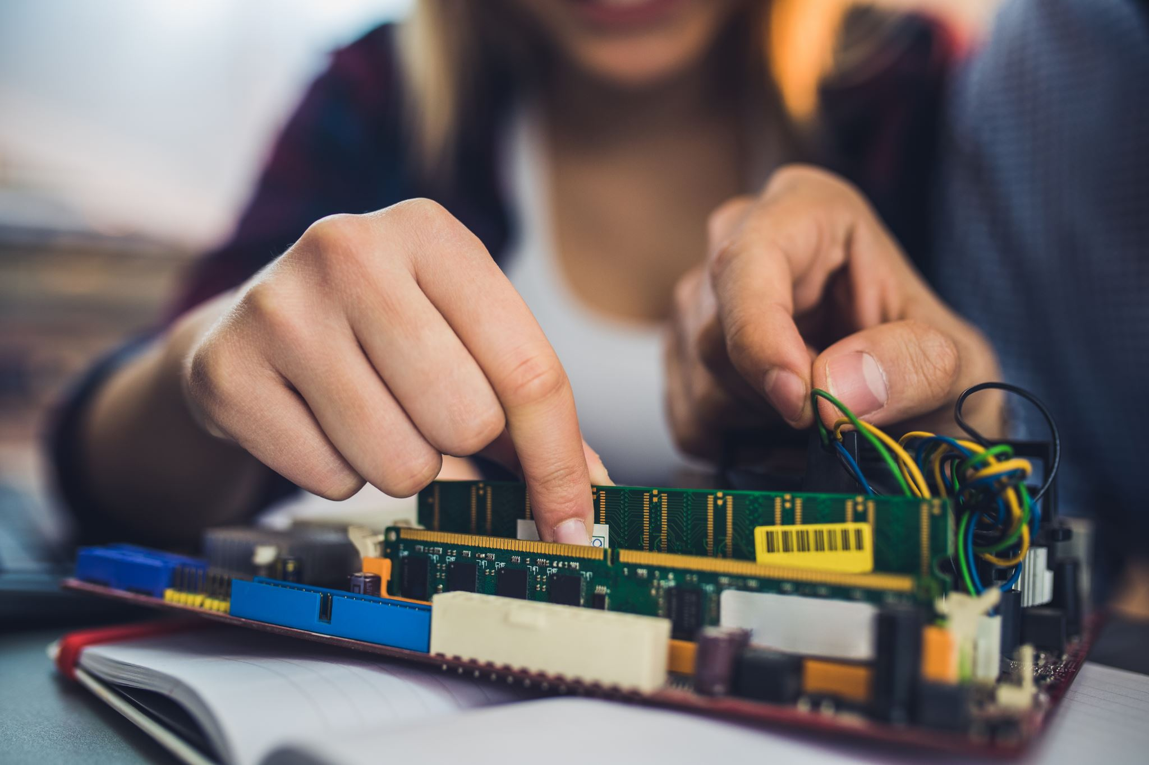


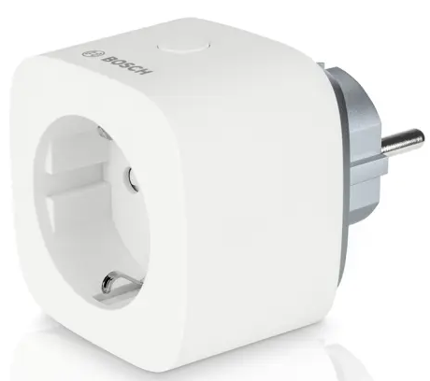
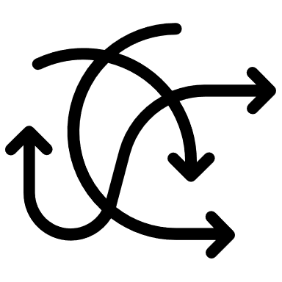

Motivation
Optimize
Understand & Control
Common Challenges Faced By Users
Figure Sources [BOSCH]
Time-consuming
Missing Technical Expertise
Complexity / Intransparancy
Reduce Energy Costs
SHawn
…
Notes:
With the Growing adoption of smart home technologies → common user difficulties occur.
Imagine a homeowner – Shawn, who has various SH devices to enhance convenience and energy efficiency in his home.
However, despite these investments in SH devices Shawn finds it challenging to understand why his energy bill stays high and how to optimize his smart home based on his habits and sometimes find it hard to get the understand what is happening in his device pool.
Why do users find it challenging?:
Time-consuming:
create automations for habits
analyze energy consumption
Getting overview of large amount of devices
Analyzing specific states like „is any window open“
Complexity/Intransparancy:
Understand the smart home and controling devices can be hard due to complexity and potential incosistencies/ missing transparency
Missing Technical Expertise:
Find it hard to create (complex) automations
Analyze energy consumption
→ Need to document temperature / power consumption
E.g. connect devices to Raspberry pi and monitor them
No tools for answering such questions in a SH

Slide 3
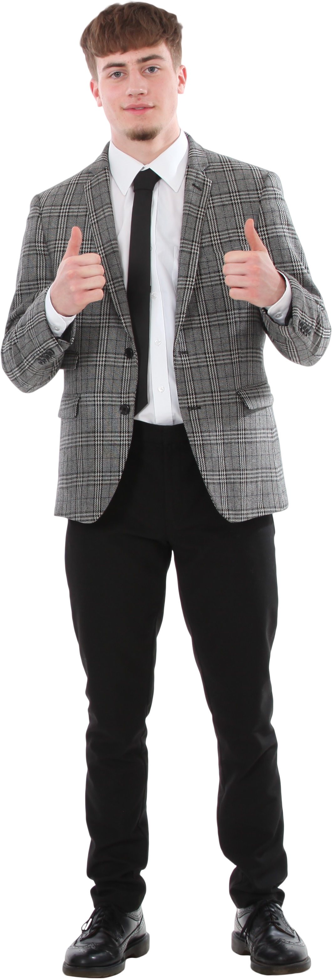



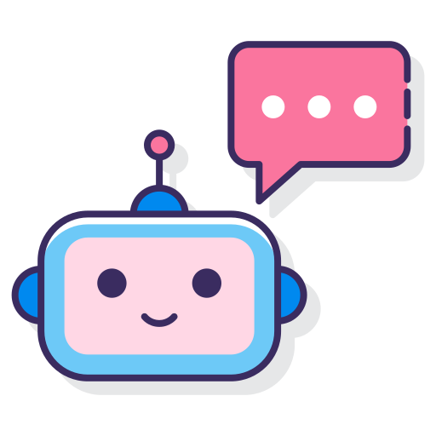


Motivation
Chatbot Figure Source [FLATICON]
Notes:
To address these interests of Shawn and the challenges mentioned:
This thesis explores development of a chatbot in the Bosch Smart Home ecosystem
Aiming to enhance explainability and user interaction
Automating and speed up the interests of users like Shawn
A chatbot can potentially assist users in understanding their smart home setup, providing clear explanations for device actions, and offering guidance on optimizing system performance.

Slide 4
Objective
Develop and investigate capabilities of a SH chatbot
Scientifical
What kind of customization of a LLM is necessary and how do different LLMs perform?
Is it plausible to develop such a chatbot especially regarding explainability and usability?
Engineerical
Assist users with answering questions and triggering actions
Provide explainability and better user experience to the user
Identify and integrate required components
Notes:
What are the specific objectives regarding this chatbot idea?
The overaching goal: Develop and investigate capabilities of SH chatbot
With focus on low budget and open source
Scientfical objective is to answer the following quesitons…
Engineerical objectives are the following…

Slide 5




Outline
Chatbot Motivation & Objective
Related Work
Methodology
Setting & LLM Customization
Conclusion & Future Work
LLM Performance & UX Study
Notes:
Future Work:
Advanced Models and Fine-Tuning
Explore larger parameter models.
Implement advanced fine-tuning/training approaches.
Enhanced Data Presentation
Develop more readable formats for device data presentation.
Improve performance through optimized data formats.
Integration of System Logs and Historical Data
Incorporate system logs and historical data functionalities.
Research effective data presentation and filtering methods.
One Sentence to each point
We started with the energy cost problem for example and a SH chatbot could help in this scenario
Then we had a look at related work (SH chatbots / complex chatbots) and fucntion calling
Subsequently the methodology which is a mix of design science and empirical research was shown
We then talked about key points of the concept and implementation of the approached chatbot, including the customization of the model through a modelfile
Finally we can conclude this thesis through the results of the evaluation:
Currently many users wouldn‘t really prefer to use a chatbot in their smart home
Need to implement more high value use cases to achieve this preference
However, an approach for building a chatbot application in the smart home area was presented that works out well even though the model and use cases can be optimized much further

Slide 6
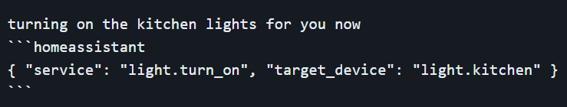
Related Work
Similar Chatbot Approaches
Advancements in LLM Function Calling
Evaluation Methods
Example chatbot response
Home LLM [aco24]
Adaptability to changing documentation [PZWG23]
No function calling Standard
Various common metrics, depending on use case [Bis23,GJL+23]
Berkeley Function-Calling Leaderboard [YMJ+24]
Notes:
Advancements in LLM Function Calling
Why is function calling important for this thesis?
Interesting is that all works I had a look at that presentted function calling models, the used models are llama based
Changing documentation: Gorilla uses a „document retriever“ for adapting real time changes
Use JSON for function calling since usual models are able to generate json, but not every model supports functon calling
Evaluation Methods
There are various articles that can be found in the internet discussing common evaluation metrics for language models
In this thesis such metrics alone are not enough since we also want to trigger actions like controlling devices
One interesting work is the BFCL (also fits into advancement in LLM function calling)
Comprehensive benchmark for function calling capabilities
Evaluates models on various function calling scenarios
Compares proprietary and open-source models
Uses AST Evaluation for structural correctness
Starting with checking the function name, parameters, detecting hallucinated parameters,...
The evaluation of this thesis has a similar part to this
Employs Executable Function Evaluation for practical performance
Checks Actual execution of functions
Similar Chatbots
Smart Home Chatbots: Control devices & answers simple questions
Many chatbots for complex use cases, like education or the goal of integrating multiple knowledge base
one work in more is especially interesting: Home LLM
Intergation for using Language Models with Home Asssistant (open source smart home management)
Multiple fine tuned LLMs, also for different languages (one language per model)
< 4B Parameters
Only basic device control and
This thesis goes beyond Home LLM and other chatbot work:
Exploring larger models (up to 12b)
Addressing more diverse and complex intents
Providing ready-to-use solution
Customization without fine-tuning

Slide 7
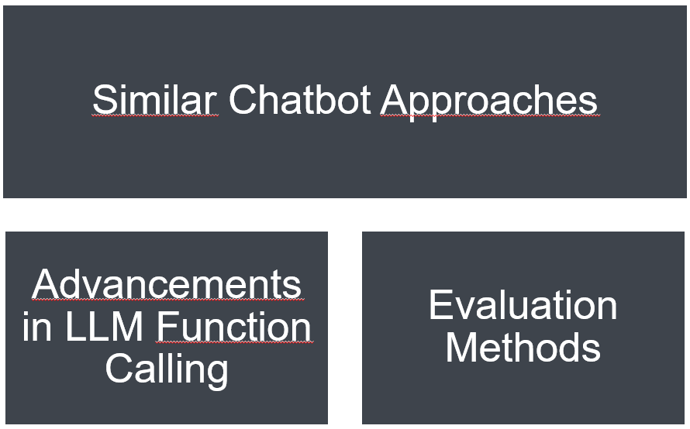
Outline
Chatbot Motivation & Objective
Related Work
Methodology
Setting & LLM Customization
Conclusion & Future Work
LLM Performance & UX Study
Notes:
Future Work:
Advanced Models and Fine-Tuning
Explore larger parameter models.
Implement advanced fine-tuning/training approaches.
Enhanced Data Presentation
Develop more readable formats for device data presentation.
Improve performance through optimized data formats.
Integration of System Logs and Historical Data
Incorporate system logs and historical data functionalities.
Research effective data presentation and filtering methods.
One Sentence to each point
We started with the energy cost problem for example and a SH chatbot could help in this scenario
Then we had a look at related work (SH chatbots / complex chatbots) and fucntion calling
Subsequently the methodology which is a mix of design science and empirical research was shown
We then talked about key points of the concept and implementation of the approached chatbot, including the customization of the model through a modelfile
Finally we can conclude this thesis through the results of the evaluation:
Currently many users wouldn‘t really prefer to use a chatbot in their smart home
Need to implement more high value use cases to achieve this preference
However, an approach for building a chatbot application in the smart home area was presented that works out well even though the model and use cases can be optimized much further

Slide 8
Methodology
Design Science
Explorative Empirical Research
Literature Review
Preliminary Surveys
User Survey for Chatbot Inputs
Iterative Prototype Development
Mixed-Methods Evaluation
Notes:
Design Science: creating an innovative chatbot to solve practical problems, using iterative development
Empirical Research: Understanding user requirements and collecting data with the user study
Literature Review:
Gain knowledge in the area
Building blocks and function calling in language models.
Similar chatbot approaches
Evaluation techniques for language model-based chatbots.
Preliminary Surveys:
With some experts
Focus on: Gain Knowledge, Requirements and Ideas
User Survey for inputs
Conducted survey with 13 participants for diverse inputs.
Collected typical queries in German and English.
Improved chatbot's understanding and performance with real user data.
Iterative Prototype Dev:
Tried to add more intents and complexity with multiple iterations and evaluating each iteration outcome
In the end the idea of adding more intents couldn’t be realized since implementation and evaluation took longer than expected
But we tried to improve our model performance
Mixed-Methods Approach:
Quantitative metrics for model performance and data from a user/case study
Qualitative analysis of semi structured interviews
I was missing in other studies: Is such a chatbot even necessary, does it help the users, do they want to use something like this?
Or is it just the typical “use GenAI” for anything
I also was missing the comparison how different models perform

Slide 9
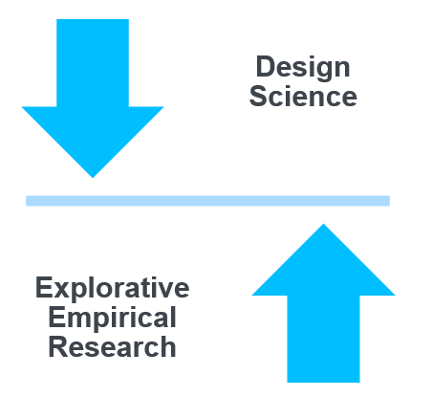
Outline
Chatbot Motivation & Objective
Related Work
Methodology
Setting & LLM Customization
Conclusion & Future Work
LLM Performance & UX Study
Notes:
Future Work:
Advanced Models and Fine-Tuning
Explore larger parameter models.
Implement advanced fine-tuning/training approaches.
Enhanced Data Presentation
Develop more readable formats for device data presentation.
Improve performance through optimized data formats.
Integration of System Logs and Historical Data
Incorporate system logs and historical data functionalities.
Research effective data presentation and filtering methods.
One Sentence to each point
We started with the energy cost problem for example and a SH chatbot could help in this scenario
Then we had a look at related work (SH chatbots / complex chatbots) and fucntion calling
Subsequently the methodology which is a mix of design science and empirical research was shown
We then talked about key points of the concept and implementation of the approached chatbot, including the customization of the model through a modelfile
Finally we can conclude this thesis through the results of the evaluation:
Currently many users wouldn‘t really prefer to use a chatbot in their smart home
Need to implement more high value use cases to achieve this preference
However, an approach for building a chatbot application in the smart home area was presented that works out well even though the model and use cases can be optimized much further

Slide 10
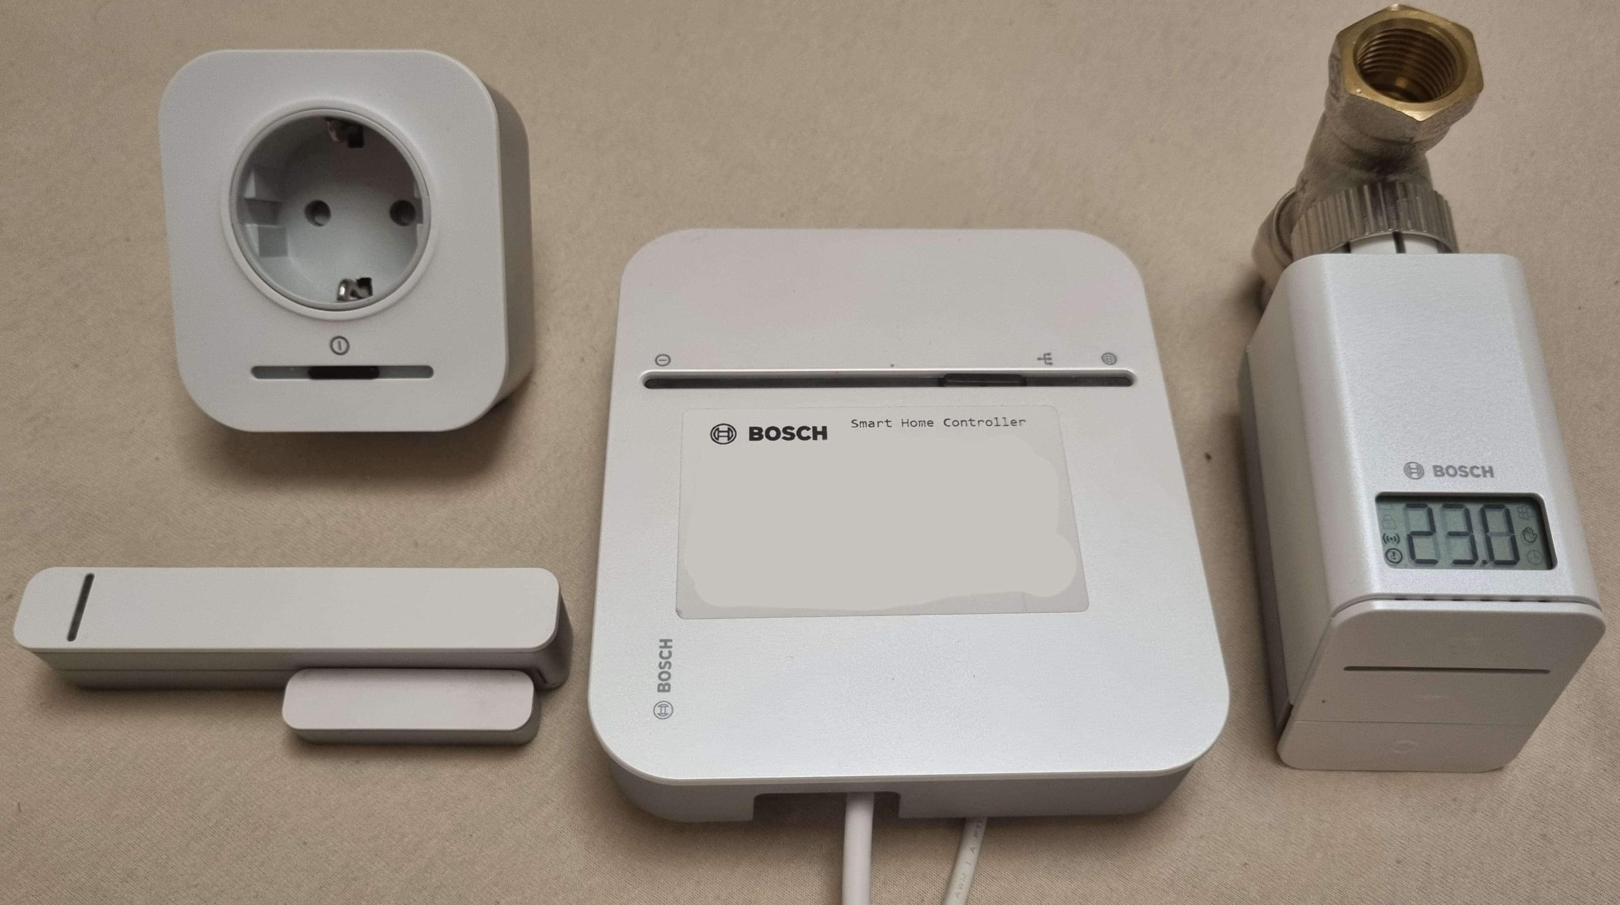

Concept
Setting
Basic Intents (Iteration 1)
Get Device Status
Intermediate Intents (Iteration2)
Assistance for Creating Automations
Complex Intents: (Iteration 3)
Analyzing Energy Consumption
Set Device Status
Interpret Device Control
Intents:
Setup:
Notes:
Get Device Status
Examples:
“What is the temperature in the living room?”
Entities: DeviceType, Room
Action/Response: Provide device status (e.g., temperature, power status).
Set Device Status
Examples:
“Set the temperature to 22 degrees in the living room.”
Entities: DeviceType, Room, DesiredStatus, DesiredValue
Action/Response: Change device status (e.g., adjust temperature, turn lights on/off).
Wasn’t able to implement the other two iterations in the available time
Assistance for Creating Automations
Function: Simplify setup of smart home automations using natural language
Interpret Device Control
Function: Provide explanations for device actions to improve transparency.
Analyzing Energy Consumption
Function: Offer insights into energy usage patterns for optimization and cost reduction.
Explain the Setup:
Using smart home devices and the Bosch Smart Home App to implement the new chatbot functionality
Only android to keep expense lower
Why Smart Home Controller?
Why this devices, why only 3?
Addressing energy consumption intents
Reducing Implementation expense through different state variables and functions of the wide product palette of Bosch

Slide 11


Implemenation
LLM Customization using Ollama
FROM llama3:instruct
PARAMETER temperature 0.95
SYSTEM “””
You are 'SHBot' (Smart Home Bot), a helpful AI Assistant that controls smart home devices. Complete tasks or answer questions based on a provided device list. “””
MESSAGE user Can you turn on my TV? MESSAGE assistant Sure, turning on the TV now. { "action": "turn-on", "deviceID": "device123", "device": "POWER_METER_SWITCH", "room": "Schlafzimmer", "name": "TV" }
Modelfile
Model
Parameters
System Message
Example Chats
Example user messages are based on a survey
Notes:
Classic Client-Server Architecture where the model is running on the server using Ollama
Due to privacy focus of Bosch, costs for an API service like OpenAI, focus on open source
While the name might suggest a connection to Meta's Llama models, Ollama is not affiliated with Meta.
It‘s an independent company that build a platform that makes it easier to run LLMs locally
For prototype purposes I tried out BWCLoud (currently free service for university members in BW) and running Ollama on my PC
For keeping the effort low I tried to customize the models through a so called modelfile
Model
How were models selected?
Tried out many different model in size 1B to 15B
What is missing in the chat is context for the LLM, which I shortly want to talk about on the next slide

Slide 12
Implemenation
Device Data
[{
"type": "POWER_METER_SWITCH",
"name": "Office Desk Lamp",
"deviceID": "12345",
"state": [
{
"id": "PowerMeter",
"state": {
"powerConsumption": 10,
"energyConsumption": 50
}
},
{
"id": "PowerSwitch",
"state": {
"switchState": "ON"
}
}
],
"room": "Office"
}]
Example Device List containing only a Smart Plug
Notes:
Where does the data come from? → app internal data model
Smart Plug
powerConsumption: Current power usage in watts
energyConsumption: Total energy consumed over time in kilowatt-hours
switchState: Whether the device is turned ON or OFF
Thermostat
valvePosition: Position of the radiator valve
childLock: Whether the child lock is ON or OFF
temperature: Current temperature measured by the thermostat in Celsius
Room Climate Control This is not a real device. It is virtually managing all thermostats in one room to achieve a desired temperature.
ventilationMode: Whether ventilation mode is active.
boostMode: Whether boost mode is active. This mode is used to increase the heat output for a short time
operationMode: Current operation mode (automatic or manual)
setpointTemperature: Desired temperature set by the user in Celsius
currentTemperature: Actual room temperature in Celsius
Door Window Contact
contactState: Whether the window or door is OPEN or CLOSED

Slide 13
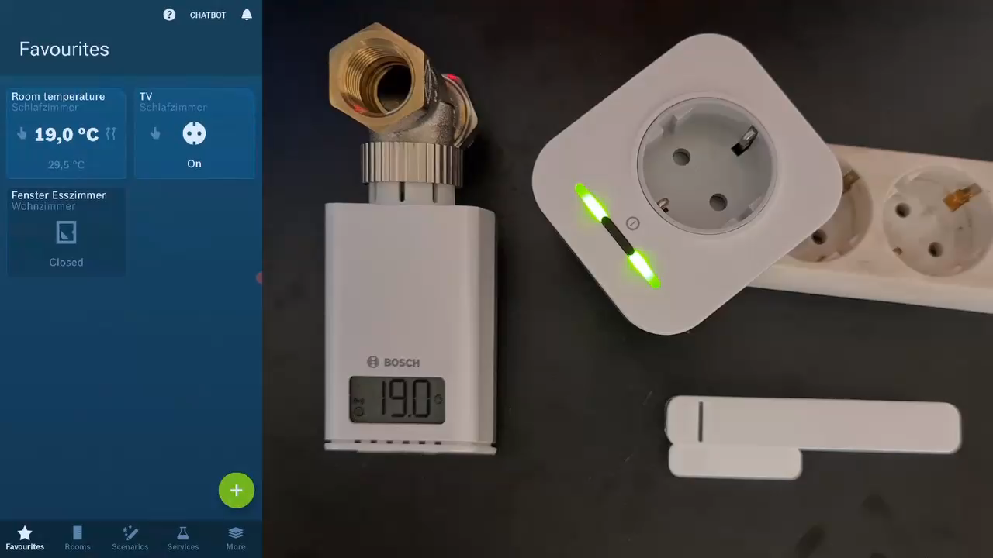
Implemenation
Demonstration

Slide 14
Outline
Chatbot Motivation & Objective
Related Work
Methodology
Setting & LLM Customization
Conclusion & Future Work
LLM Performance & UX Study
Modelfile
Model
Parameters
System Message
Example Chats
Notes:
Future Work:
Advanced Models and Fine-Tuning
Explore larger parameter models.
Implement advanced fine-tuning/training approaches.
Enhanced Data Presentation
Develop more readable formats for device data presentation.
Improve performance through optimized data formats.
Integration of System Logs and Historical Data
Incorporate system logs and historical data functionalities.
Research effective data presentation and filtering methods.
One Sentence to each point
We started with the energy cost problem for example and a SH chatbot could help in this scenario
Then we had a look at related work (SH chatbots / complex chatbots) and fucntion calling
Subsequently the methodology which is a mix of design science and empirical research was shown
We then talked about key points of the concept and implementation of the approached chatbot, including the customization of the model through a modelfile
Finally we can conclude this thesis through the results of the evaluation:
Currently many users wouldn‘t really prefer to use a chatbot in their smart home
Need to implement more high value use cases to achieve this preference
However, an approach for building a chatbot application in the smart home area was presented that works out well even though the model and use cases can be optimized much further

Slide 15
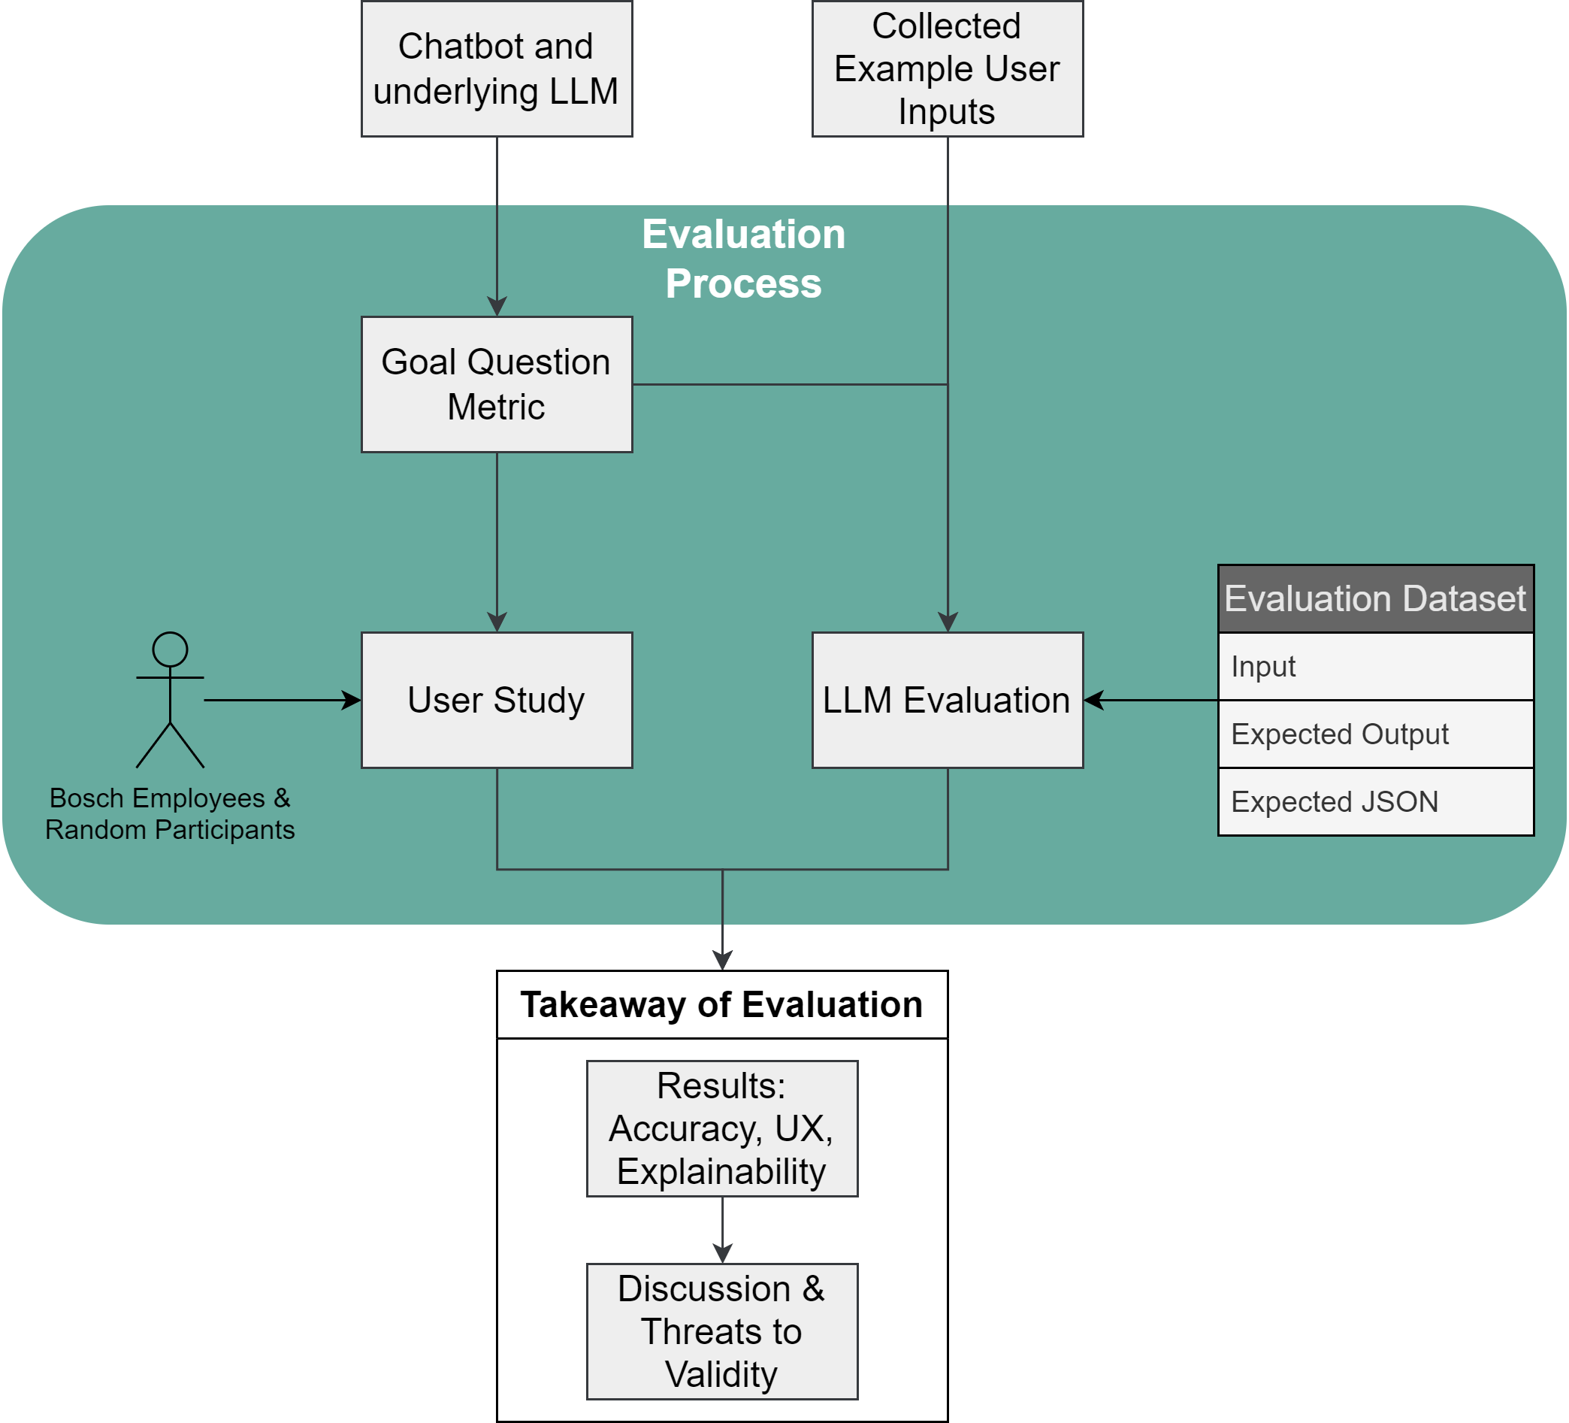
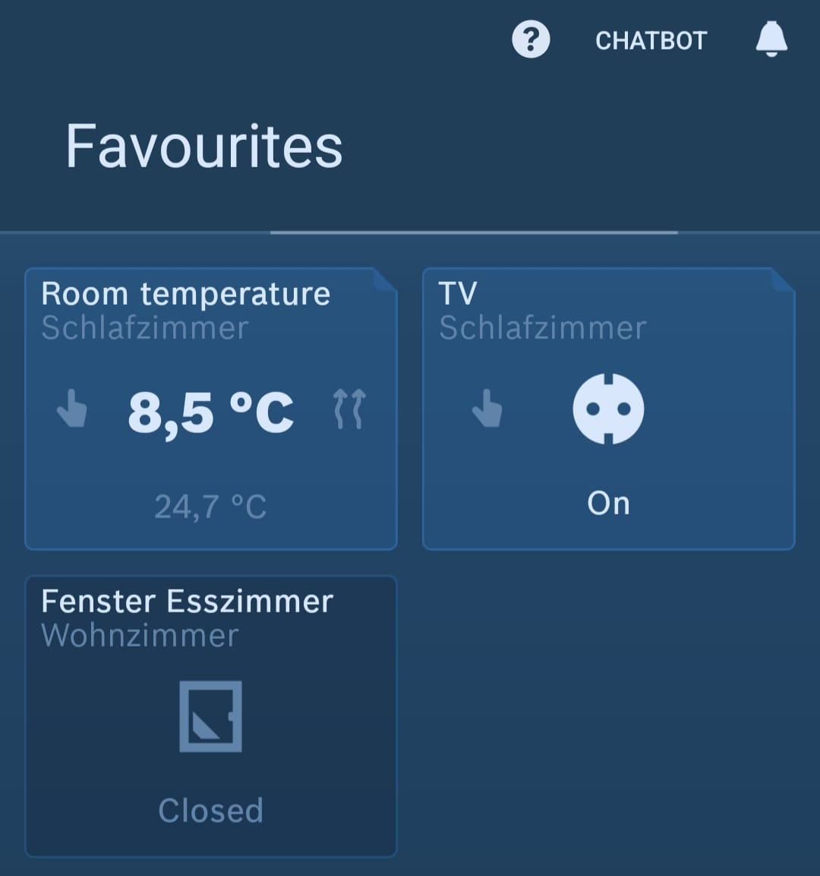
Evaluation Process
Notes:
GQM:
Goals are to evaluate based on accuracy, user experience and explainability
Describe the process further, start with LLM evaluation
LLM eval:
Needed to create a dataset for evaluation
Example input messages used from survey mixed with some device lists
Created 10 device list, some random, some edge cases
Explain thermostat → Room Climate Control
Output consists of a natural language part and a json (can be empty)
Individual and combined metrics for evaluation (next slide)
User Study:
10 participants: three from bosch, others mostly students. Different familiarity with smart homes and chatbot usage.
Setup of three devices
6 Task: Information Retrieval and Device Control
Collected completion time, attempts per task and whether the completion was succesful
Post-Experiment Survey:
Liker-Scale adressing usability, explainability and
E.g. „the responses were clear and helpful“
Semi-structured interview to get insights into: confusion,
→ quantitative and qualitative evaluation

Slide 16
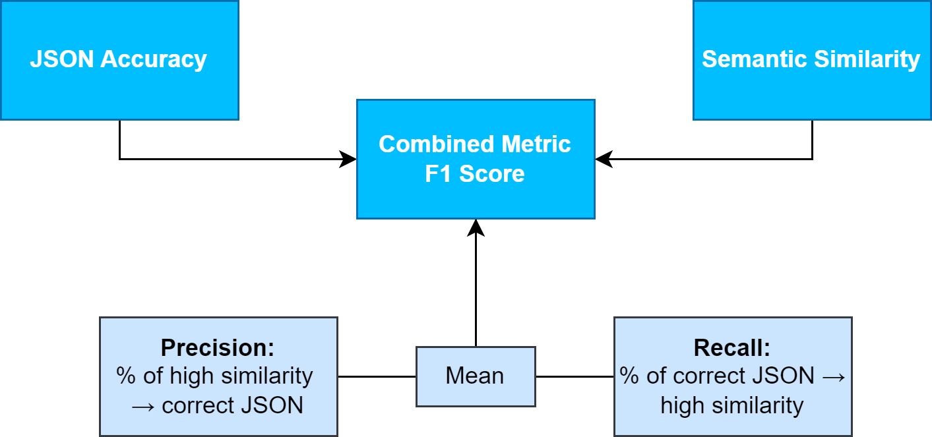
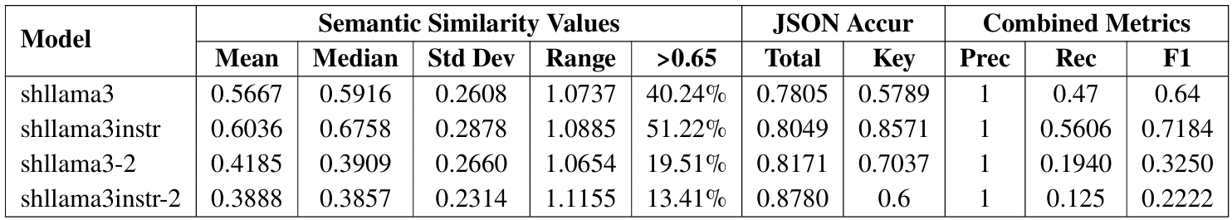
Results
Model Performance
Notes:
First, I want to talk about the model performance.
Initially much more models were selected but were sorted out with a short selection test
If a model didn’t pass this test, it was not further considered for evaluation
The test contained 3 typical user inputs and corresponding outputs
Besides llama3 and llama3instruct all models didn’t understand the structure of the provided messages with the device list
Therefore, the table shows two different versions of llama3 / instruct
Tried to fine tune but I guess it was leading to overfitting
Evaluation dataset consists of model output, expected output and expected JSON
Semantic Similarity
how closely the generated responses from the chatbot match the expected outputs in terms of meaning
We see mean and median of different customized models
But to decide whether
→ 0.65, we will talk about why this is a solid valie on the next slide
JSON Accuracy
We define JSON accuracy as the percent of correctly generated JSONs
All values are not perfect but a good starting point
Combined:
Using both values to construct correct and incorrect cases
A correct case is where json is correct and similarity is over 0.65
Precision is the percent of cases where semantic similarity is over 0.65 implies that the json is also correct
Recall is the other way around
Interesting observations:
The plain llama3 model performs worse as the instruct version in both: similarity/jsonAccur.
The second version of llama3instruct has the highest json accuracy but has much worse semantic similarity
Making its responses quite unsuitable
All models have a precision of 1: meaning when the similarity is high the corresponding json is correct
We have much more correct jsons than similarity values, therefore it makes sense
Overall shllama3instr ist the best trade off between json accuracy and semantic similarity

Slide 17
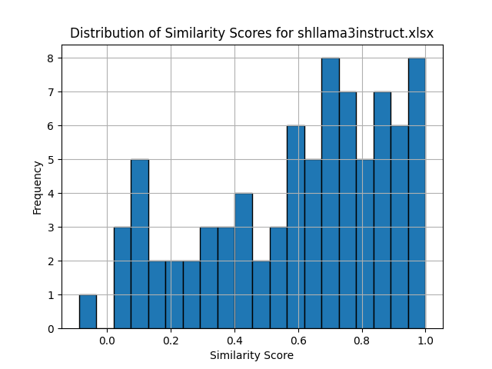
Results
~51% are over 0.65
~60% are over 0.6
~67% are over 0.5
~75% are over 0.4
Model Performance
What is a good Value?
Example with 0.61:
Response:
“I cannot have a temperature measurement for the kitchen. There are only rooms and devices, but no temperature-taking devices available for the kitchen.”
Expected:
“I’m sorry, but no temperature sensors are available in the kitchen”
Another Aspect: Answering in users‘ language
Notes:
Explain the graph:
We saw on the last slide that for this model that 51% are >0.65
we can also kinda see this in this histogram
Many of the values around 0.4 are probably when the bot responded in the wrong language
Many values are close to the threshold
~60% are over 0.6
~67% are over 0.5
~75% are over 0.4
Answers in the wrong language are typically under 0.55
How is the value calculated?
SentenceTransformer Model to compute cosine similarity (between the generated and expected output)
Value is between -1 and 1
is calculated by taking the dot product of the normalized (length is 1) embeddings of two sentences, which represents the cosine of the angle between them.
A model is needed to calculate the similarity because it transforms sentences into embeddings that capture their meanings and contextual nuances
Way to complex to discuss in detail
Discuss good Value:
The tricky part with this metric is to analyze for your specific use case what a good value is
This also depends on the calculating model/metric chosen for evalution
Original example is in german (sounds a bit worse in german, bad choice of words)
Wrong language outputs are typically under 0.55 and therefore are also not accepted by this strict choice of 0.65

Slide 18



Results
User Study Hypothesis
𝐻1 The chatbot improves explainability of the app.
𝐻2 The chatbot improves usability of the app.
𝐻3 Persons would rather use the chatbot than traditional ways of controlling their smart home.
𝐻4 Controlling device tasks generally take longer than tasks where no action needs to be triggered.
Analysis through Wilcoxon Test and qualitative findings.
Notes:
Hypothesis 1: The chatbot improves explainability of the app
Strong Support: Significant results in Q4 (p-value = 0.0097) and Q5 (p-value = 0.0139) indicate that users found the chatbot’s responses clear and helpful, and the smart home’s behavior understandable after chatbot interactions.
Q4 The chatbot’s responses were clear and helpful. Q5. The smart home’s behavior after the chatbot’s responses was understandable
Statistical Evidence: The Wilcoxon test results provide strong support for improved explainability​(6_Evaluation)​.
Hypothesis 2: The chatbot improves usability of the app
Moderate to Strong Support: Q3 showed a p-value of 0.0532, suggesting a trend towards improved usability, though not statistically significant.
Q3 The chatbot enhances the usability of the app.
User Perception: Users generally found the chatbot intuitive and easy to use, with a mean score of 4.20 for ease of use​(6_Evaluation)​.
Hypothesis 3: Persons would rather use the chatbot than traditional ways of controlling their smart home
No Support: Q6 showed a non-significant result (p-value = 1.0000), indicating no strong preference for the chatbot over traditional methods.
Q6 I would use the chatbot if it was added to the official app
Integration Potential: Neutral mean score (3.00) suggests users see value but are not fully convinced of its superiority​(6_Evaluation)​.
Hypothesis 4: Controlling device tasks generally take longer than tasks where no action needs to be triggered
Strong Support: Significant results for task completion times (T5 and T6 vs T1-T4) with p-values of 0.0039 and 0.0020, respectively, showing device control tasks took longer than information retrieval tasks​(6_Evaluation)​.
The Wilcoxon signed-rank test for hypothesis 4 involves comparing two sets of related samples to evaluate whether their population mean ranks differ. For hypotheses 1, 2, and 3, the tests compared pre- and post-intervention scores on various usability and explainability metrics.

Slide 19





Key Findings / Contributions
Performance Trade-off
Enhanced Explainability and Usability
Designed Example Architecture
User Preference: under construction
High-Value Use Cases: multi-device management, automations, energy analysis
Notes:
Performance Trade-off:
It was not possible in our work to have the best json accuracy and semantic similarity and the same time
Best model: shllama3instr - balanced performance
Compare to Home LLM: 97% accuracy, but only simple controls of devices and simple questions are supported
No natural language metrics like similarity are presented
Compare to BCFL: Best Models have between 80 and 90% accuracy (even proprietary models)
F1 score hard to compare to other work. In general a value over 0.7 is a good starting point.
Trying to further improve the model by changing the modelfile resulted in overfitting
Improved explainability and usability as schown through hypothesis testing
Repsones were usually clear and helpful
Participants were only confused when the model said it would do something it then didn’t do (like turning on the smart plug)
Designed Example Architecture
Everything works out fine but there is probably much space for improving the LLM
Essentially you could just take my modelfile and API Client and build a mapper class around it to use it for other Smart Home vendors.
The architecture could also be used for other use cases where it is beneficial to host the model yourself
For production using a tool like langchain could be benefitial
Not yet preferred over traditional interfaces
Overall the participants where neutral regarding the statement “I would use the chatbot over traditional interfaces”.
One participant for example said “Google Home” does all of that for me
Which I personally don’t agree with
But also people that would use it
For example for getting a quick overview when you have many devices
High-Value Use Cases
multi-device management, automations, energy analysis
Listed just a few.
Or even suggestions for improving the home

Slide 20
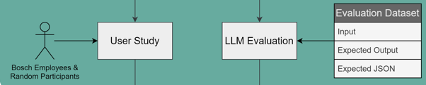
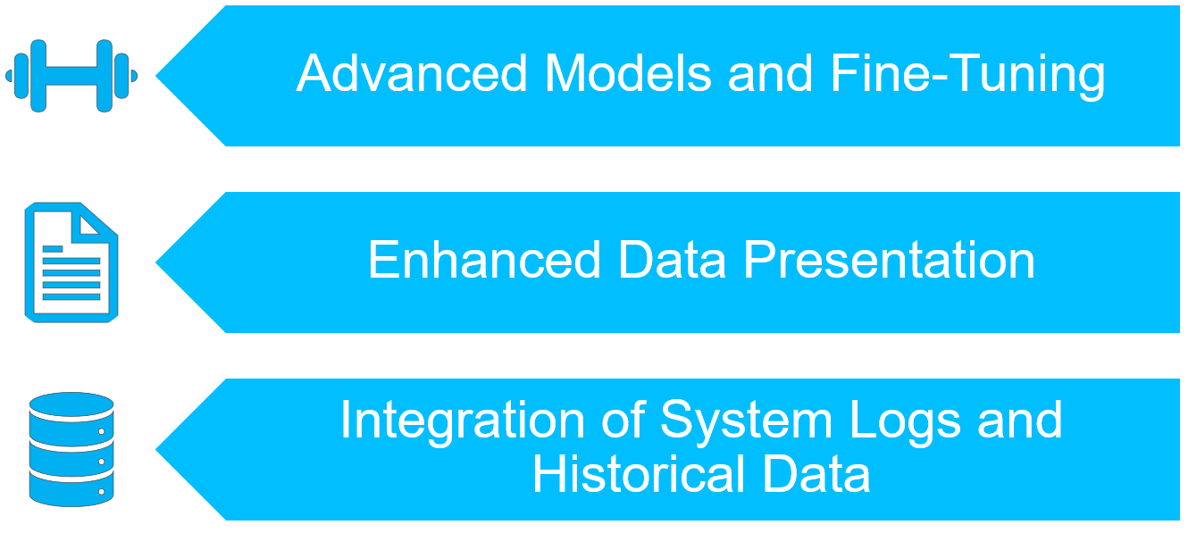
Outline
Chatbot Motivation & Objective
Related Work
Methodology
Setting & LLM Customization
Conclusion & Future Work
LLM Performance & UX Study
Modelfile
Model
Parameters
System Message
Example Chats
Notes:
Future Work:
Advanced Models and Fine-Tuning
Explore larger parameter models.
Implement advanced fine-tuning/training approaches.
Enhanced Data Presentation
Develop more readable formats for device data presentation.
Improve performance through optimized data formats.
Integration of System Logs and Historical Data
use system logs and historical data to address use cases like energy analysis
(Research effective data presentation and filtering methods.)
One Sentence to each point
We started with the energy cost problem for example and a SH chatbot could help in this scenario
Then we had a look at related work (SH chatbots / complex chatbots) and fucntion calling
Subsequently the methodology which is a mix of design science and empirical research was shown
We then talked about key points of the concept and implementation of the approached chatbot, including the customization of the model through a modelfile
Finally we can conclude this thesis through the results of the evaluation:
Currently many users wouldn‘t really prefer to use a chatbot in their smart home
Need to implement more high value use cases to achieve this preference
However, an approach for building a chatbot application in the smart home area was presented that works out well even though the model and use cases can be optimized much further

Slide 21
Q&A
Notes:
End the presentation with this slide
Open for a discussion now
So, how can I help you?

Slide 22
Extra Slides & References

Slide 23
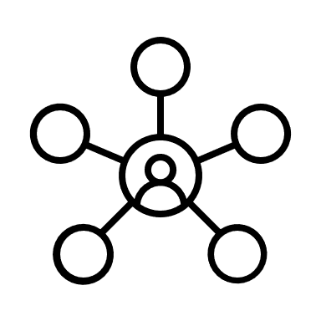



Foundations
Natural Language Understanding (NLU)
Connects human language and AI
Knowledge Base
Stores domain-specific data, facts, and contextual information
Enables chatbot to adress intents
Intent
Represents different user intentions that a chatbot anticipates
Enables comprehension of intents

Slide 24
Relation to State of the Art
Similar Chatbots: Home LLM [aco24]
Key components:
Local LLM integration
Custom fine-tuned LLM (< 4b parameters)
Features:
Chat interface for device control and basic Q&A
Supports various backends (e.g., Ollama, LocalAI)
Training:
synthetic dataset for teaching function
Limitations:
Focused primarily on basic device control and simple queries
Uses tiny language models
Notes:
Intergation for using Language Models with Home Asssistant (open source smart home management)
Multiple fine tuned LLMs, also for different languages (one language per model)
This thesis goes beyond Home LLM and other chatbot work:
Exploring larger models (up to 12b)
Addressing more diverse and complex intents
Providing ready-to-use solution
Customization without fine-tuning

Slide 25
Relation to State of the Art
Advancements in LLM Function Calling
Recent Models
Gorilla (Llama-based)
NexusRaven (CodeLlama13b-based)
Key Improvements
Challenge
No function calling Standard
Surpassing commercial models like GPT4
Adaptability to changing documentation
Reduced Errors & Hallucinations
Notes:
Why is function calling important for this thesis?
Interesting is that both models are llama based
Changing documentation: Gorilla uses a „document retriever“ for adapting real time changes
Use JSON for function calling since usual models are able to generate json, but not every model supports functon calling

Slide 26
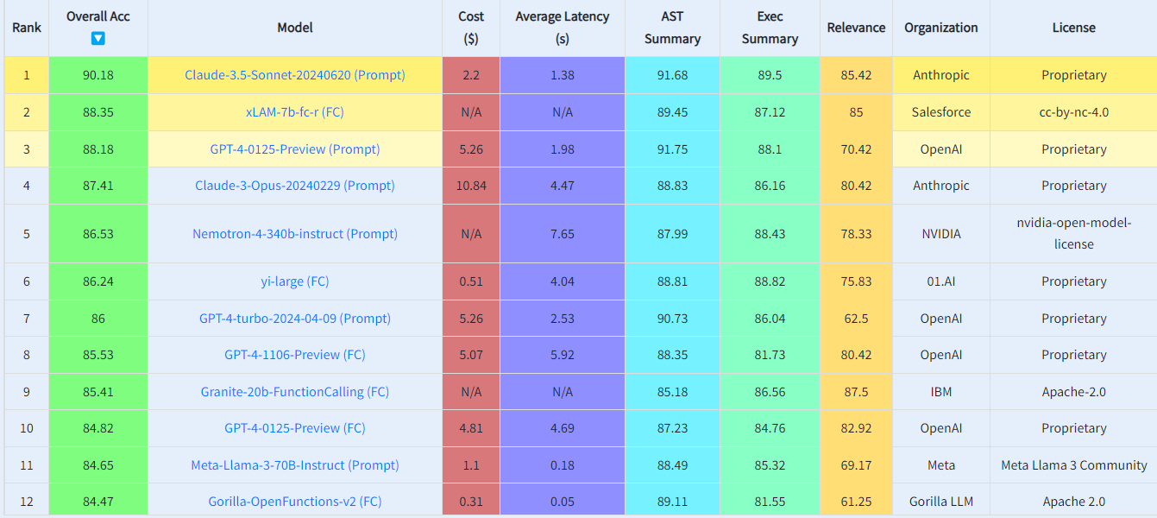
Related Work: Evaluation Methods
Berkeley Function Calling Leaderboard [YMJ+24]
Notes:
Comprehensive benchmark for function calling capabilities
Evaluates models on various function calling scenarios
Uses AST Evaluation for structural correctness
Employs Executable Function Evaluation for practical performance
Compares proprietary and open-source models

Slide 27
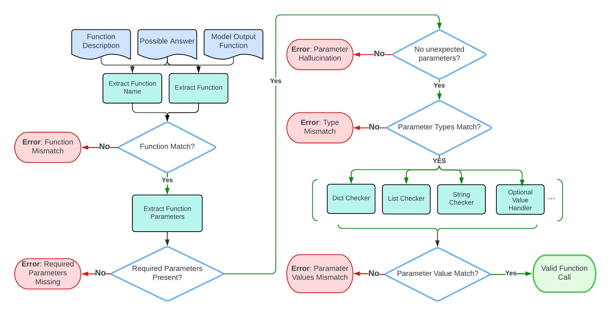
Related Work: Evaluation Methods
Berkeley Function Calling Leaderboard [YMJ+24]
Notes:
Comprehensive benchmark for function calling capabilities
Evaluates models on various function calling scenarios
Uses AST Evaluation for structural correctness
Employs Executable Function Evaluation for practical performance
Compares proprietary and open-source models

Slide 28
Relation to State of the Art
What is different in this thesis?
Exploring larger models (up to 12b)
Addressing more diverse and complex intents
Providing ready-to-use solution
Evaluating generalization without fine-tuning
Notes:
Evaluating Generalization Without Fine-Tuning: A key focus of this thesis is to determine how far larger models can be pushed without the need for fine-tuning, by leveraging pre-trained capabilities and customizing them for specific use cases.

Slide 29
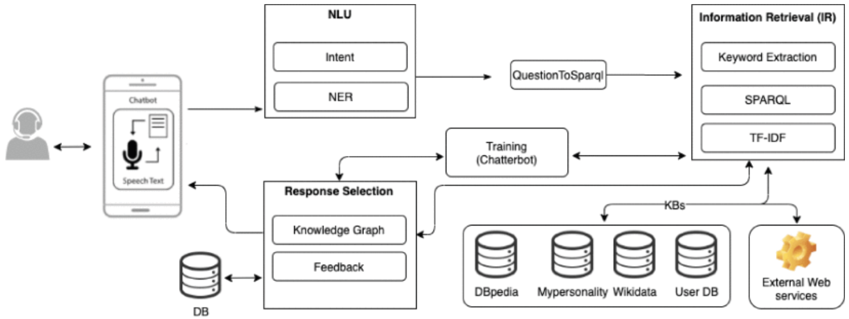
Relation to State of the Art
Chatbots for complex scenarios
[AJ20]
Notes:
Dont want to dive to deep into this but want to show how a complex chatbot could look like just as an inspirtation
Just mentioned artifacts: Intents, NLU, Knowledge Bases
Translate intents to a query to search for data in the KBs
In the end a response is selected based on the named components and a trained chatbot

Slide 30
Concept
Preliminary Surveys
Gain Knowledge, Requirements and Ideas
Discussion of Intents
Tools/
Technologies
Data
Evaluation
Challenges
General Approval
LLM vs. NER
User inputs
Smart Home data
Model performance
User satisfaction
Privacy / Trust
Notes:
Interviewed 4 experts from different domains.
Product designer and a developer from BSH
Researcher with knowledge in Language Models
Team Lead of AskBosch
Proposed Intents:
Overall the users found the proposed intents interesting but also had additional ideas
For example User-specific recommendations based on behavior or charging the electric car at the time with the cheapest electricity cost
Tools and Technologies:
Consideration of LLM vs. NER for capabilities and resource constraints.
Recommendations for frameworks like Microsoft Bot Framework, Dialogflow, and LangChain.
Choice depends on chosen architecture: classical client server?
Data Organization:
Use of predefined configurations mapping intents to actions.
Gathering diverse user inputs for training models and performance evaluation.
Leveraging logs from smart home devices and user behavior data.
Evaluation
(Getting example inputs for the setting we approach)
We discussed with users the criteria and metrics that would be most meaningful for assessing the chatbot’s performance
Searching for a suitable metric, e.g., F1 score and also do a user evaluation
Challenges and Pitfalls:
Complexity in creating sophisticated automations.
Addressing data privacy and trust issues (
pointed out issues such as privacy concerns, integration difficulties, and the learning curve associated with new technology
Ensuring sufficient computational resources and managing development costs

Slide 31
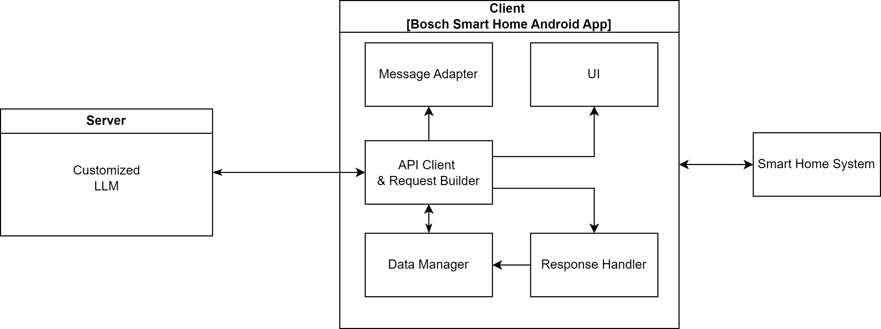
Concept
Architecture

Slide 32
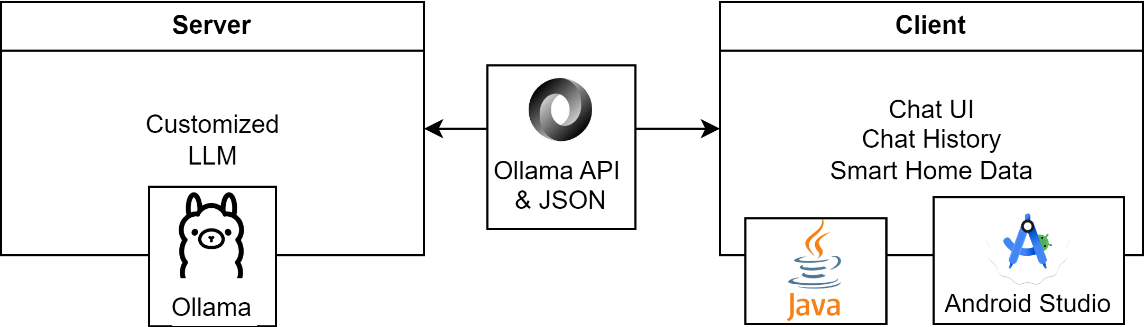
Implemenation
Overview

Slide 33
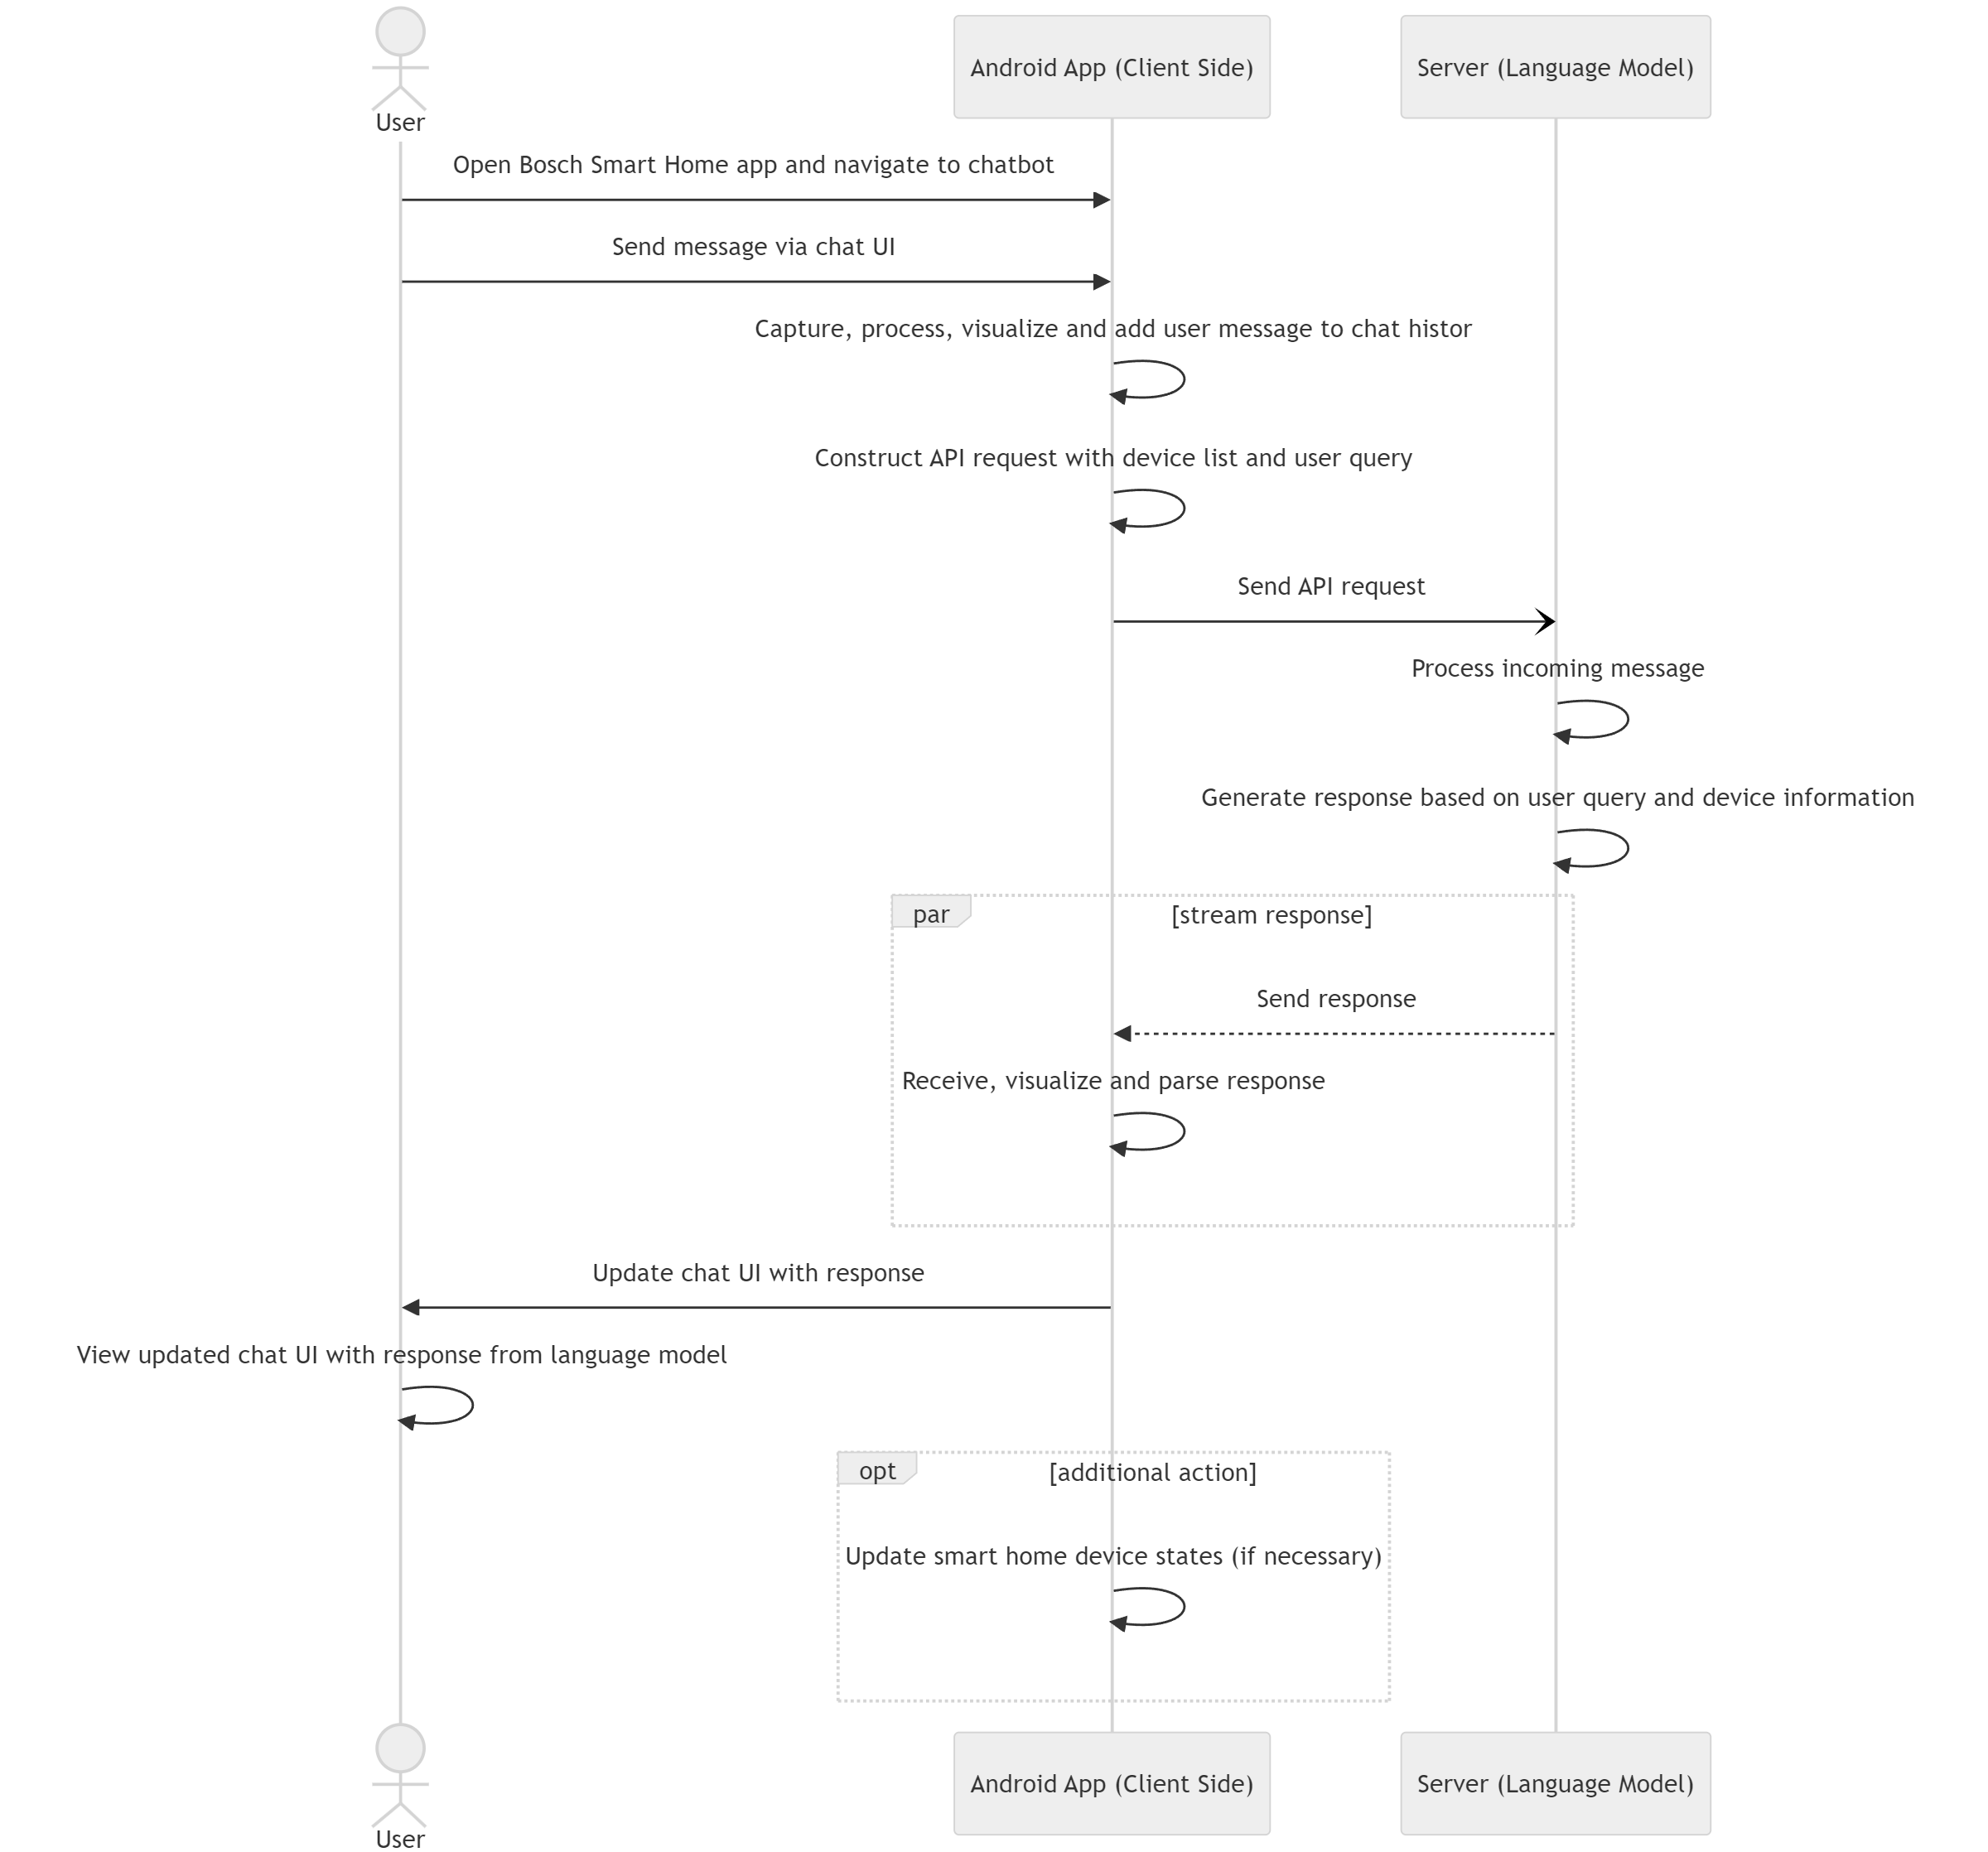
Implemenation
Interaction Flow

Slide 34
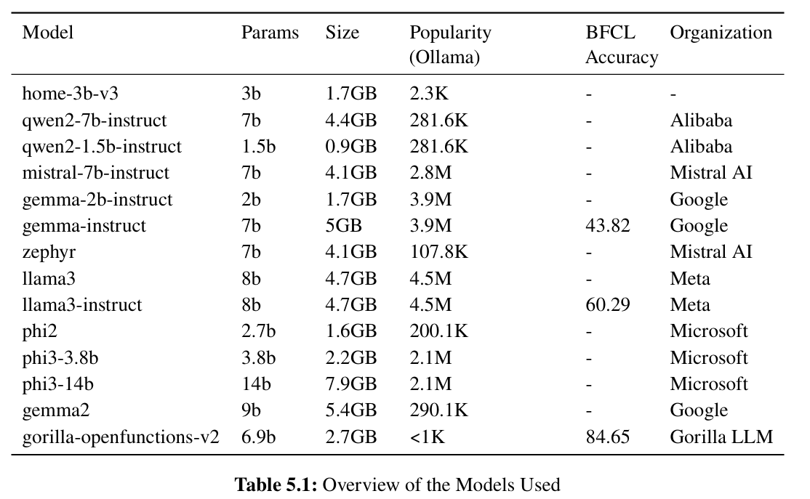
Implemenation
Models used

Slide 35
Implemenation
Example Device List containing only a Smart Plug
Device Data
[{
"type": "POWER_METER_SWITCH",
"name": "Office Desk Lamp",
"deviceID": "12345",
"state": [
{
"id": "PowerMeter",
"state": {
"powerConsumption": 10,
"energyConsumption": 50
}
},
{
"id": "PowerSwitch",
"state": {
"switchState": "ON"
}
}
],
"room": "Office"
}]
Device | Collected State Data
Smart Plug | powerConsumption energyConsumption switchState (On/Off)
Thermostat | childLock temperature
Room Climate Control (virtual device) | modeInformation setpointTemperature currentTemperature
Door Window Contact | contactState (Open/Closed)
Notes:
Where does the data come from? → app internal data model
Smart Plug
powerConsumption: Current power usage in watts
energyConsumption: Total energy consumed over time in kilowatt-hours
switchState: Whether the device is turned ON or OFF
Thermostat
valvePosition: Position of the radiator valve
childLock: Whether the child lock is ON or OFF
temperature: Current temperature measured by the thermostat in Celsius
Room Climate Control This is not a real device. It is virtually managing all thermostats in one room to achieve a desired temperature.
ventilationMode: Whether ventilation mode is active.
boostMode: Whether boost mode is active. This mode is used to increase the heat output for a short time
operationMode: Current operation mode (automatic or manual)
setpointTemperature: Desired temperature set by the user in Celsius
currentTemperature: Actual room temperature in Celsius
Door Window Contact
contactState: Whether the window or door is OPEN or CLOSED

Slide 36
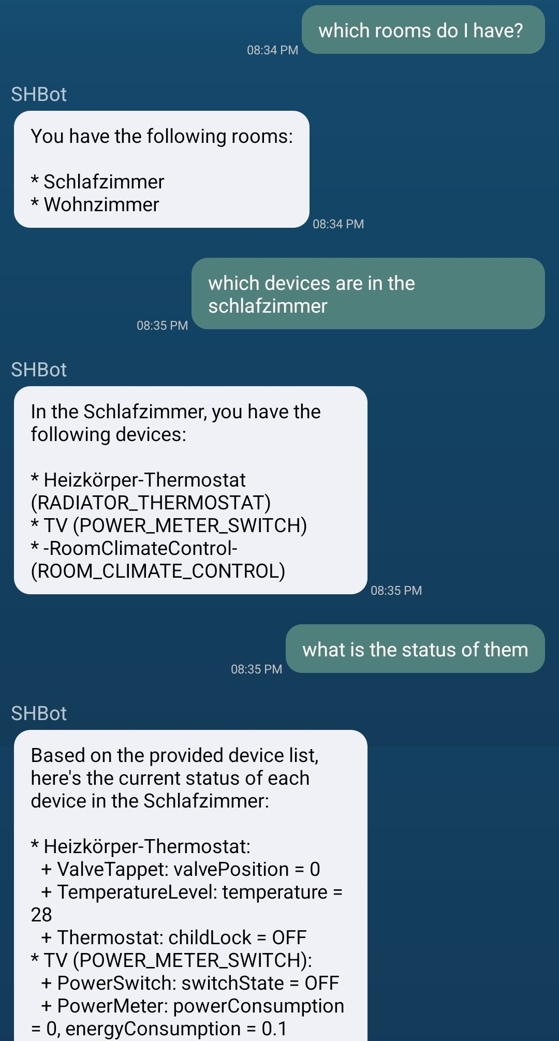
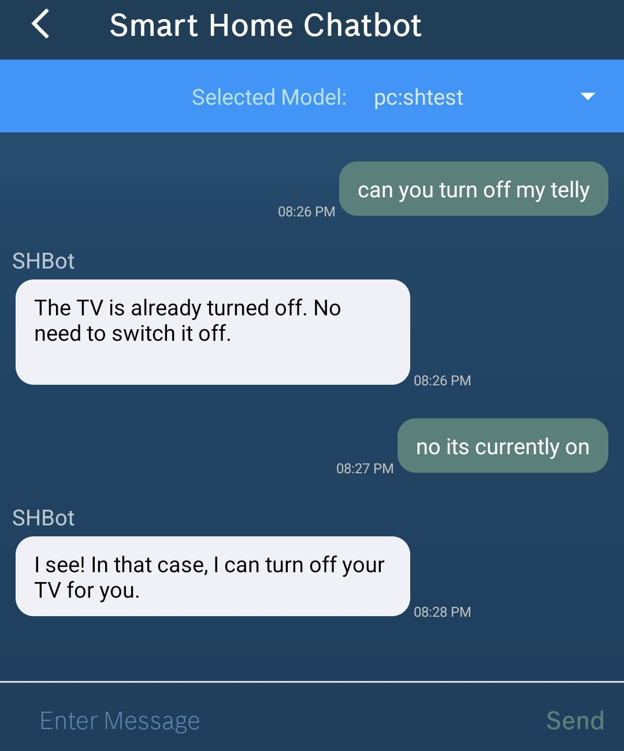
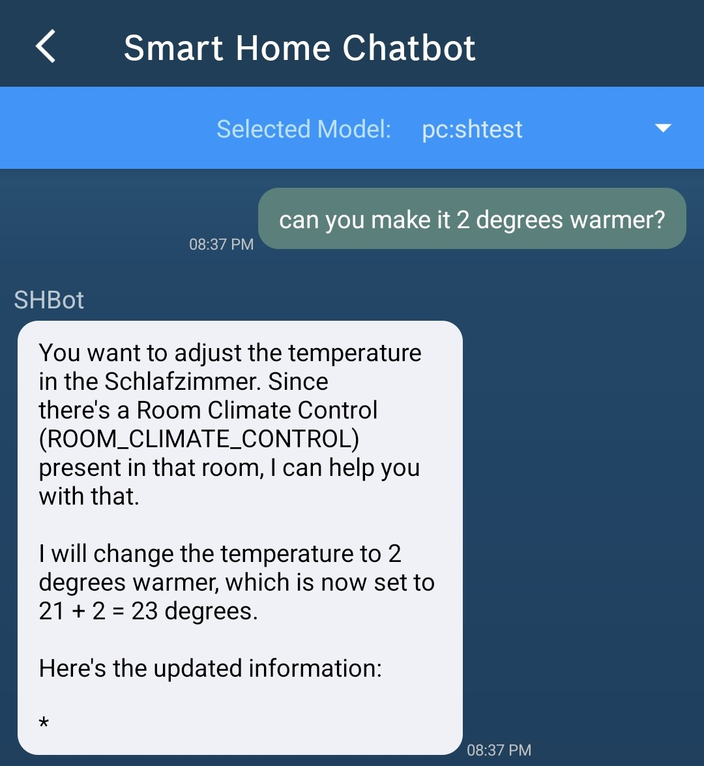
Example Chats
Notes:
…

Slide 37
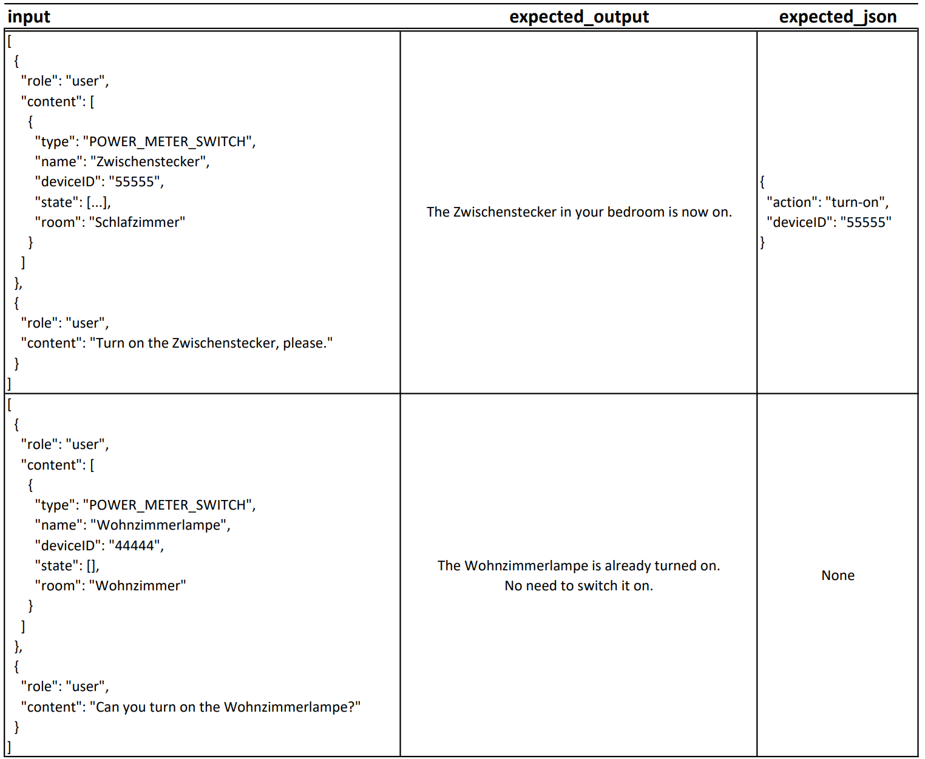
Dataset Example Entries

Slide 38
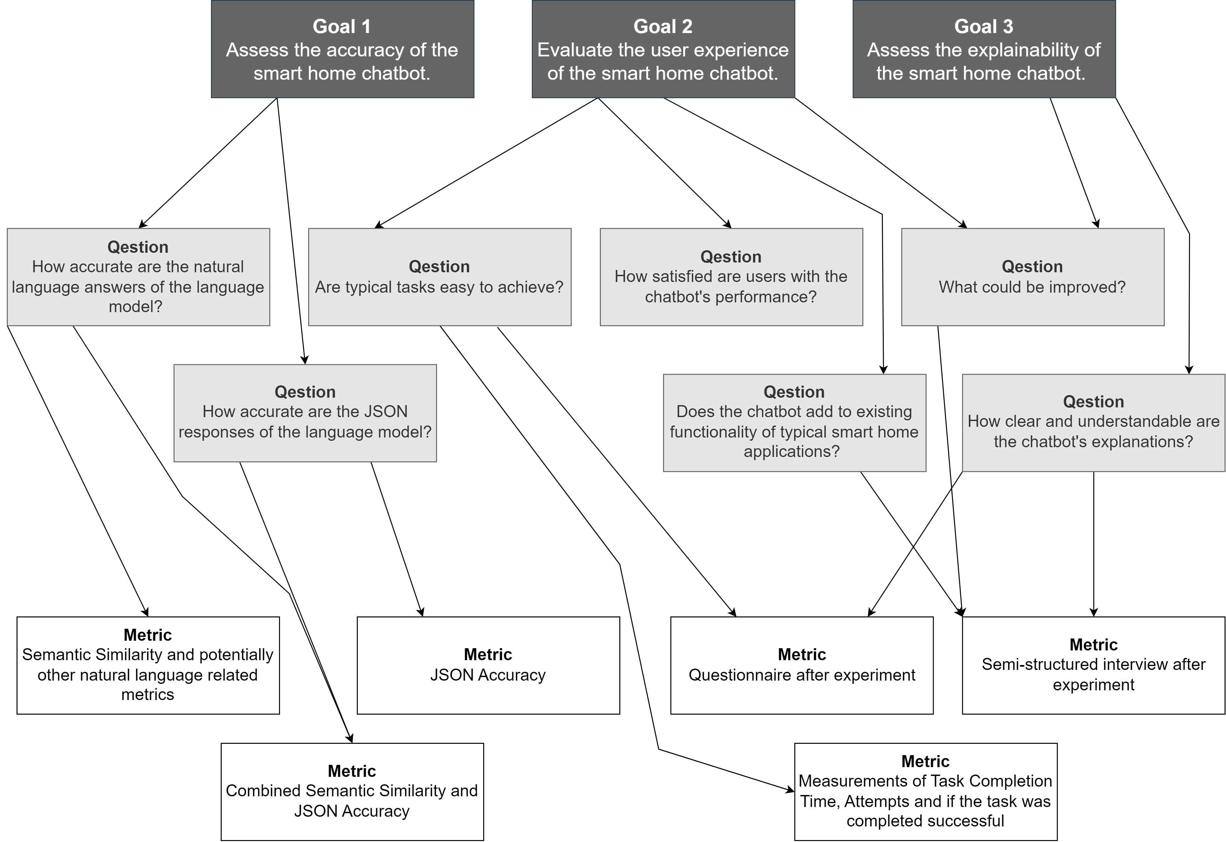
Goal Question Metric

Slide 39
Model Evaluation
Metrics
Notes:
True Positive (TP): Cases where the model’s output has high semantic similarity (above a defined threshold) and the generated JSON is correct.
False Positive (FP): Cases where the model’s output has high semantic similarity but the generated JSON is incorrect.
True Negative (TN): Cases where the model’s output has low semantic similarity and the generated JSON is incorrect.
False Negative (FN): Cases where the model’s output has low semantic similarity but the generated JSON is correct.
Based on these definitions, we calculate precision, recall, and F1 score as follows:
Precision: Of all the outputs the model that have a high semantic similarity, how many were actually positive cases (generated JSON is also correct).
Recall: Of all the actual positive cases (generated JSON is correct), how many did the model correctly identify as positive (semantic similarity is also high).
F1Score: The harmonic mean of precision and recall, providing a single measure of performance.

Slide 40
User Study
Procedure & Metrics
Tasks
Asking the chatbot what it is for
Likert-Scale Survey
Ease of Use
Semi-structured Interview
2 device control tasks
3 information gathering tasks
Measuring completion time, attempts, succesfullness
User Experience
Suggestions for Improvement
Additional Functionalities
Are Responses clear/helpful?
Would users use the chatbot?
Better Usability?
Quantitative Data
Qualitative Data

Slide 41
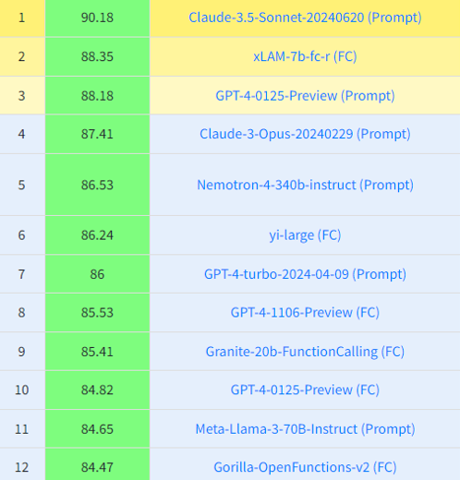
Discussion
Model Performance
Can compete with general much larger models?
Can compete with fine tuned Home LLM?
Claims to have 97.11%
Only JSON Accuracy Comparison possible
Model | Accuracy
shllama3 | 0.7805
shllama3instr | 0.8049
Shllama3-2 | 0.8171
Shllama3-instr-2 | 0.8780

Slide 42
Similar Chatbot Approaches: Relation to State of the Art
Chatbots for Smart Homes
Similar to known voice assistants
Chatbots for Complex Scenarios
Knowledge graph-based chatbot for linked data [AJ20]
Containerized network management chatbot [JQFF23]
Facebook chatbot [APM+20]
Teaching a SH assistant [CA21]
Chatbot controlling SH devices conntected to a Raspberry Pi [BKS17]
Chatbot for Data Science and Machine Learning [CCI+20]
Similar Chatbots
Home LLM: project for Home Assistant for controlling the smart home through a local LLM [aco24]
Notes:
SH chatbots:
Control devices & answers simple questions
Teaching without data sources, only based on user inputs…

Slide 43
Threats to Validity
Construct Validity
Potential errors in evaluation dataset
Limitations in JSON evaluation script
Internal Validity
Participant bias due to familiarity with Bosch Smart Home
External Validity
Limited participant diversity and small sample size
Reliability
Subjectivity in qualitative analysis
Metrics choice and implementation variability
Specific device setup may not generalize
Notes:
Learning effects could occur even when the task order is randomized

Slide 44
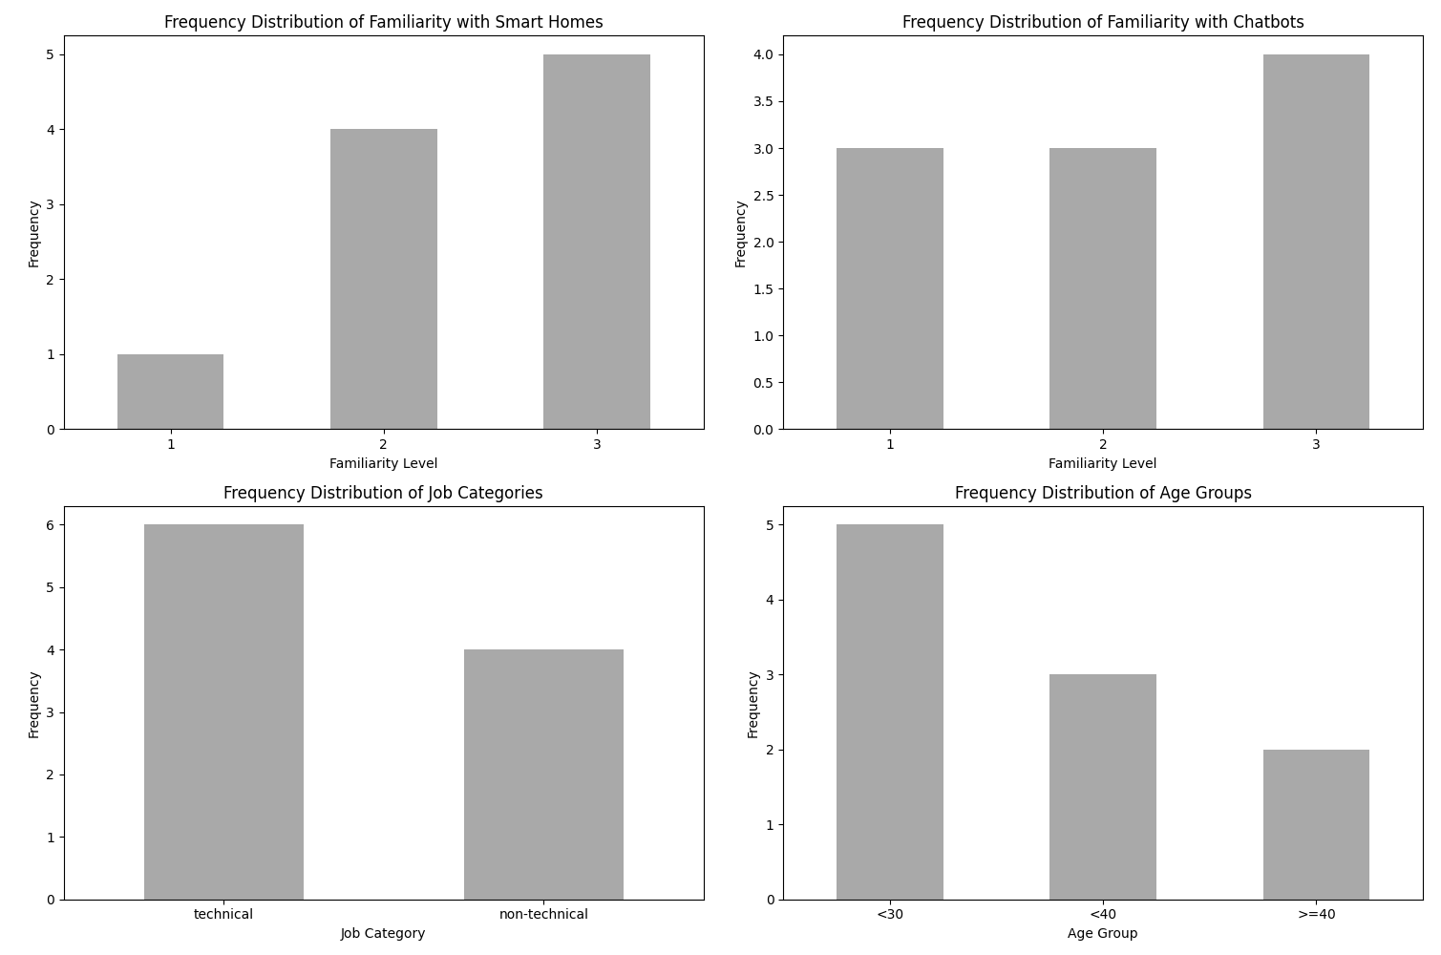
User Study
Participants

Slide 45
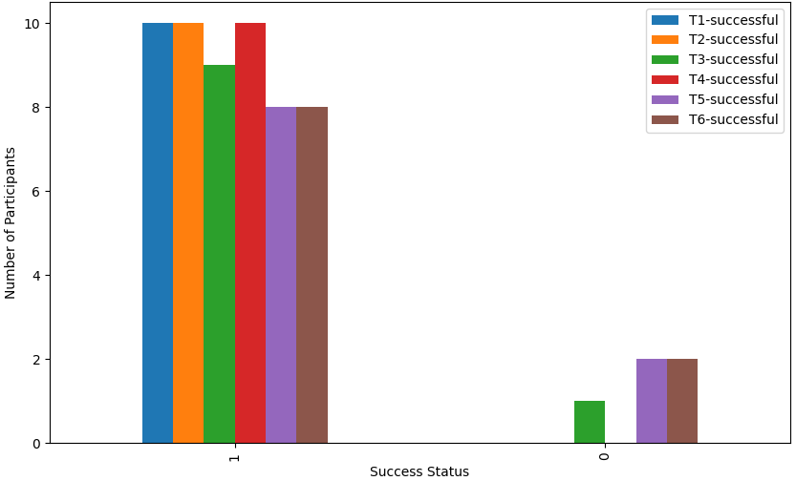
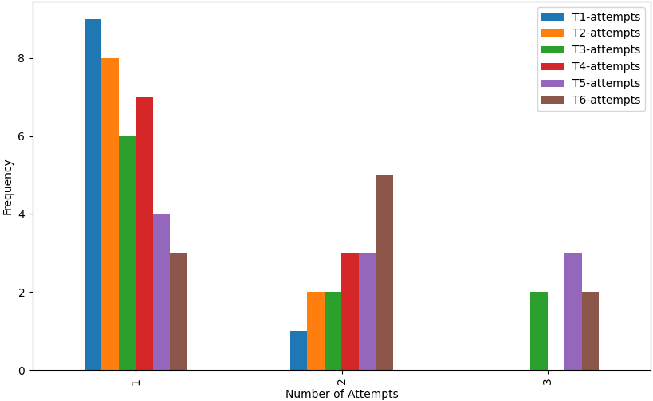
User Study
Successful Tasks and Number of Attempts

Slide 46
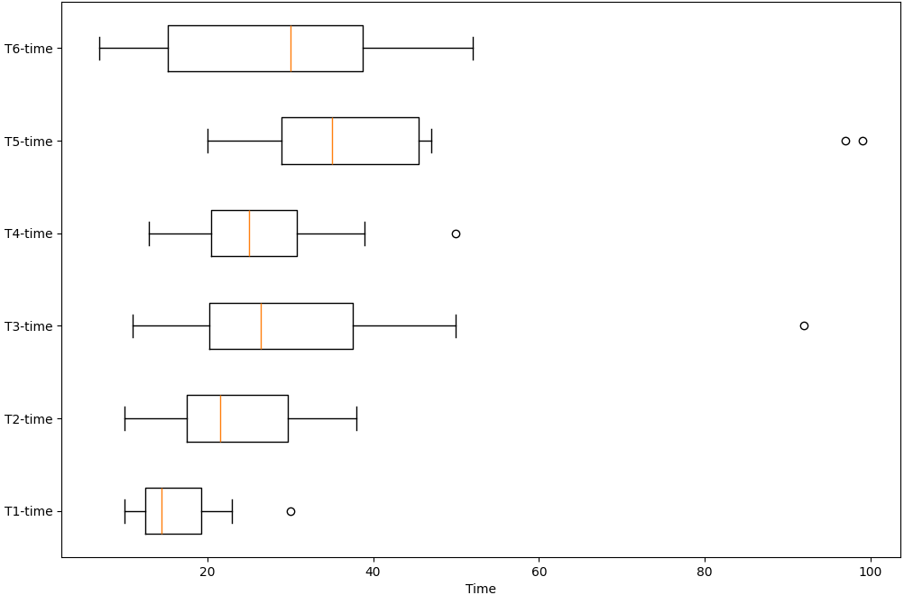
User Study
Time Needed per Task as a Box Plot

Slide 47
Future Work
Advanced Models and Fine-Tuning
Enhanced Data Presentation
Integration of System Logs and Historical Data
User Interaction and Acceptance
Notes:
Advanced Models and Fine-Tuning
Explore larger parameter models.
Implement advanced fine-tuning/training approaches.
Enhanced Data Presentation
Develop more readable formats for device data presentation.
Improve performance through optimized data formats.
Integration of System Logs and Historical Data
Incorporate system logs and historical data functionalities.
Research effective data presentation and filtering methods.
User Interaction and Acceptance
Investigate the impact of visual elements and voice interaction.
Conduct larger-scale user studies with diverse participants.
Trust/Security?

Slide 48
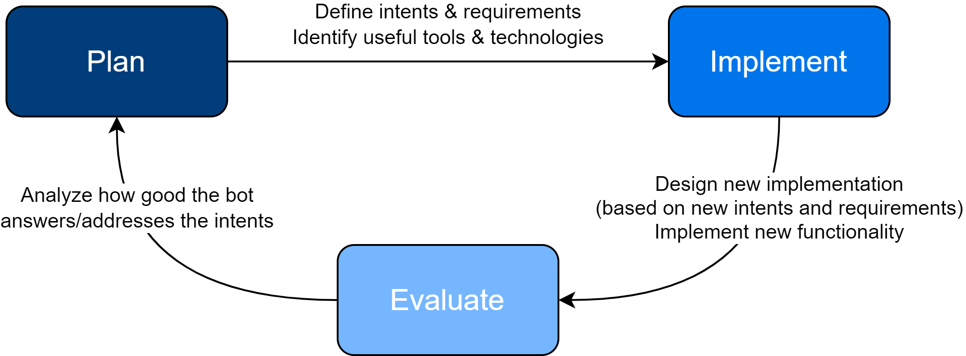
Work Plan & Schedule
Notes:
The underlying process is iteratively designed
Based on extreme programming release cycle and prototype development
Just describe the process…

Slide 49
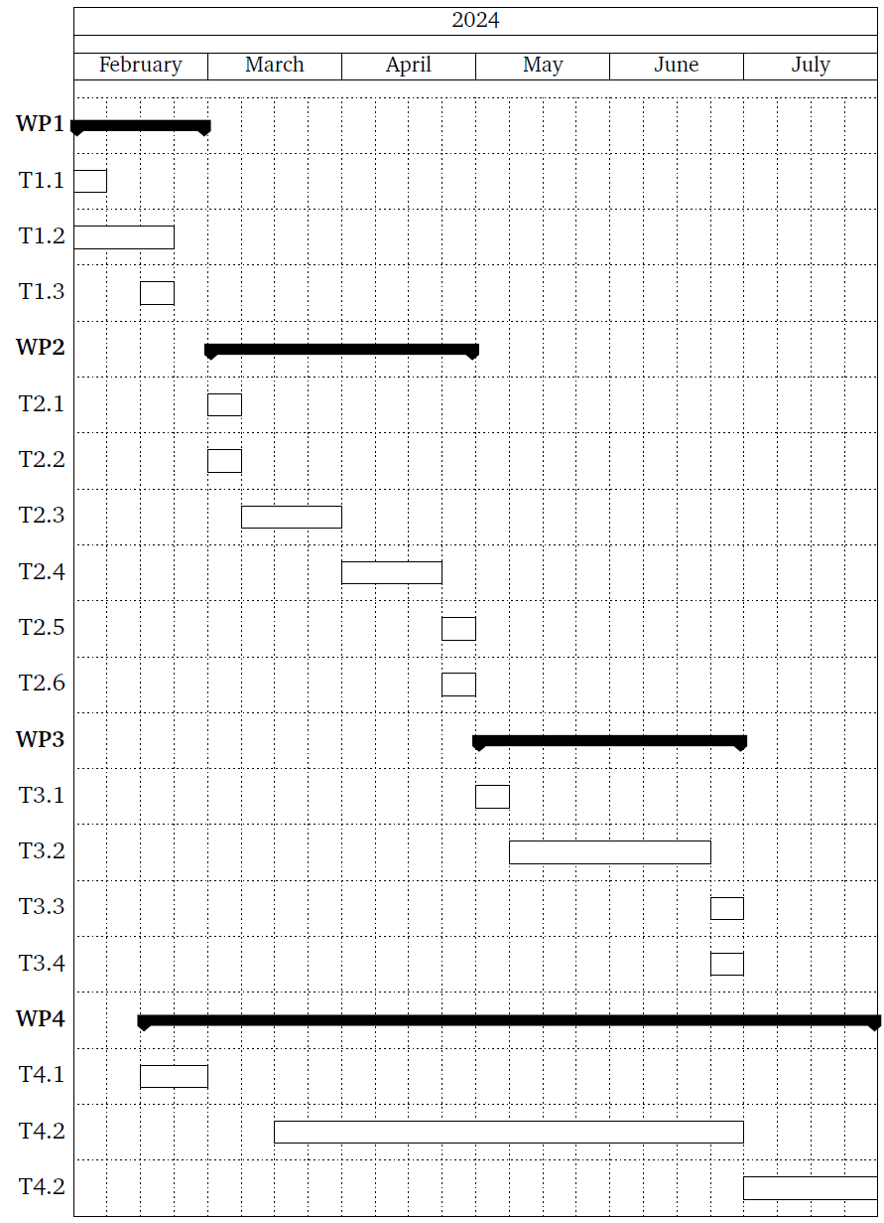
Work Plan & Schedule
Literature & Tool Research
Initial Iteration of Prototype Development
Further Iterations
Documentation
Notes:
Literature & tool research:
Deeper insight into chatbot development and architecture
Iterations:
2 months
Plan -> Implement -> evaluate
Implement has the longest duration
Iteration duration only estimated
Could be a single iteration in worst case
Documentation in parallel to write a draft
Refined at the end

Slide 50
Detailed WPs
WP2 Initial Iteration of Prototype Development
Define Key Features, Functionalities, Intents
Translate Concepts into Design/Development
Develop&Implement initial chatbot architecture
Design&Implement knowledge base
Evaluate Prototype’s performance
Plan for future iterations
WP3 Further Iterations
Define new and refine features/intents
Implement new functionality
Evaluate Prototype‘s performance
Plan future iterations/work

Slide 51
References
[aco24] acon96. home-llm. 2024. url: https://github.com/acon96/home-llm
[AJ20] A. Ait-Mlouk, L. Jiang. “KBot: A Knowledge Graph Based ChatBot for Natural Language Understanding Over Linked Data.” In: IEEE Access 8 (2020). Conference Name: IEEE Access, pp. 149220–149230. ISSN: 2169- 3536. DOI: 10.1109/ACCESS.2020.3016142. URL: https://ieeexplore.ieee.org/abstract/document/9165716
[AM20] E. Adamopoulou, L. Moussiades. “An Overview of Chatbot Technology.” en. In: Artificial Intelligence Applications and Innovations. Ed. by I. Maglogiannis, L. Iliadis, E. Pimenidis. IFIP Advances in Information and Communication Technology. Cham: Springer International Publishing, 2020, pp. 373– 383. ISBN: 978-3-030-49186-4. DOI: 10.1007/978-3-030-49186-4_31
[APM+20] S. Ahmed, D. Paul, R. Masnun, M.U. A. Shanto, T. Farah. “Smart Home Shield and Automation System Using Facebook Messenger Chatbot.” In: 2020 IEEE Region 10 Symposium (TENSYMP). ISSN: 2642-6102. June 2020, pp. 1791–1794. DOI: 10.1109/TENSYMP50017.2020.9230716. URL: https://ieeexplore.ieee.org/abstract/document/9230716
[Bis23] R. Biswas. “Evaluating Large Language Models (LLMs): A Standard Set of Metrics for Accurate Assessment”. In: (2023)
[BKS17] C. J. Baby, F. A. Khan, J. N. Swathi. “Home automation using IoT and a chatbot using natural language processing.” In: 2017 Innovations in Power and Advanced Computing Technologies (i-PACT). Apr. 2017, pp. 1–6. DOI: 10.1109/IPACT.2017.8245185. URL: https://ieeexplore.ieee.org/abstract/document/8245185
[CA21] M. Chkroun, A. Azaria. “A Safe Collaborative Chatbot for Smart Home Assistants.” en. In: Sensors 21.19 (Jan. 2021). Number: 19 Publisher: Multidisciplinary Digital Publishing Institute, p. 6641. ISSN: 1424-8220. DOI: 10.3390/s21196641. URL: https://www.mdpi.com/1424-8220/21/19/6641
[CCI+20] D. Carlander-Reuterfelt, Á. Carrera, C. A. Iglesias, Ó. Araque, J. F. Sánchez Rada, S. Muñoz. “JAICOB: A Data Science Chatbot.” In: IEEE Access 8 (2020). Conference Name: IEEE Access, pp. 180672–180680. ISSN: 2169- 3536. DOI: 10.1109/ACCESS.2020.3024795. URL: https://ieeexplore.ieee.org/abstract/document/9200315
[GJL+23] Z. Guo, R. Jin, C. Liu, Y. Huang, D. Shi, Supryadi, L. Yu, Y. Liu, J. Li, B. Xiong, D. Xiong. Evaluating Large Language Models: A Comprehensive Survey. 2023. doi: 10 . 48550 / arXiv . 2310 . 19736. arXiv: 2310 . 19736 [cs.CL]. url: https://arxiv.org/abs/2310.19736
[JQFF23] A. Jasinski, Y. Qiao, E. Fallon, R. Flynn. “Chatbot-based Feedback for Dynamically Generated Workflows in Docker Networks.” In: 2023 IEEE 9th International Conference on Network Softwarization (NetSoft). ISSN: 2693-9789. June 2023, pp. 287–289. DOI: 10.1109/NetSoft57336.2023. 10175429. URL: https://ieeexplore.ieee.org/abstract/document/10175429
[PZWG23] S. G. Patil, T. Zhang, X. Wang, J. E. Gonzalez. Gorilla: Large Language Model Connected with Massive APIs. 2023. doi: 10 . 48550 / arXiv . 2305 . 15334. arXiv: 2305.15334 [cs.CL]. url: https://arxiv.org/abs/2305.15334
[SDZ+23] V. K. Srinivasan, Z. Dong, B. Zhu, B. Yu, H. Mao, D. Mosk-Aoyama, K. Keutzer, J. Jiao, J. Zhang. “NexusRaven: A Commercially-Permissive Language Model for Function Calling”. In: NeurIPS 2023 Foundation Models for Decision Making Workshop. 2023. url: https://openreview.net/forum?id=5lcPe6DqfI
[Som11] I. Sommerville. Software Engineering. en. Google-Books-ID: l0egcQAACAAJ. Pearson, 2011. ISBN: 978-0-13-705346-9
[YMJ+24] F. Yan, H. Mao, C. C.-J. Ji, T. Zhang, S. G. Patil, I. Stoica, J. E. Gonzalez. Berkeley Function Calling Leaderboard. https://gorilla.cs.berkeley.edu/blogs/8_berkeley_function_calling_leaderboard.html 2024

Slide 52
Other Sources
[FLATICON] Chatbot Icon: https://www.flaticon.com/de/kostenloses-icon/chatbot_2040946
[BOSCH] Bosch Smart Home Pictures https://www.bosch-smarthome.com/

